Slide 1
ESSEX PARTNERSHIP UNIVERSITY NHS FOUNDATION TRUST
ESTATE STRATEGY

Slide 2
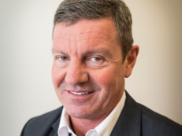
Estate Strategy 2024
Essex Partnership University NHS Foundation Trust (EPUT) has been on a journey of improvement and we remain committed to driving forward change, to learning, listening and innovating so that we deliver the highest quality and safest care possible.
As we look to the future, the role of our estate is critical in supporting our vision of being the leading health and wellbeing service in the provision of mental health and community care. Our estates strategy therefore serves as a vital blueprint for our commitment to delivering high quality, accessible and sustainable health care services.
Our estate strategy is a comprehensive forward-thinking plan that sets out how we will develop our estate over the next 10 years, ensuring that it is fit for purpose and aligns with our strategic goals. As we navigate the complexities of modern healthcare, our estate must not only respond to current needs but also anticipate future challenges.
In developing our strategy, we have engaged widely with stakeholders including patients, staff and system partners. Their insights and experiences have been fundamental in shaping our strategy and has helped us with our mission in being a leading health and wellbeing service.
Our strategy also embraces our suite of enabling strategies including digital, quality of care, social impact and working in partnership with people and communities. We have also embraced the principles of sustainability, recognising our responsibility to incorporate sustainable development aiming to reduce energy consumption, minimise waste and enhance the overall environmental performance of our estate.
This strategy is a living document, designed to evolve as we grow and adapt to new challenges. Further work will also be required to develop site masterplans and delivery plans.
We are excited about the future and the role our estate will play in it. With this strategy as our guide, we are confident that EPUT will continue to innovate, adapt and excel in meeting the healthcare needs of our communities. Together, we will build an estate that supports our mission to provide outstanding care and improve the health and wellbeing of the people that we serve.
FOREWORD
Paul Scott
Chief Executive
Trevor Smith
Executive Chief Finance and Resources Officer
Martin Mizen
Senior Director, Estates and Facilities
P.2

Slide 3
Estate Strategy 2024
Page
01
6
INTRODUCTION
02
WHERE ARE WE NOW?
8
03
20
WHERE DO WE WANT TO BE?
04
HOW DO WE GET THERE?
47
05
FUNDING DELIVERY AND MEASURING SUCCESS
61
06
APPENDICES
65

Slide 4
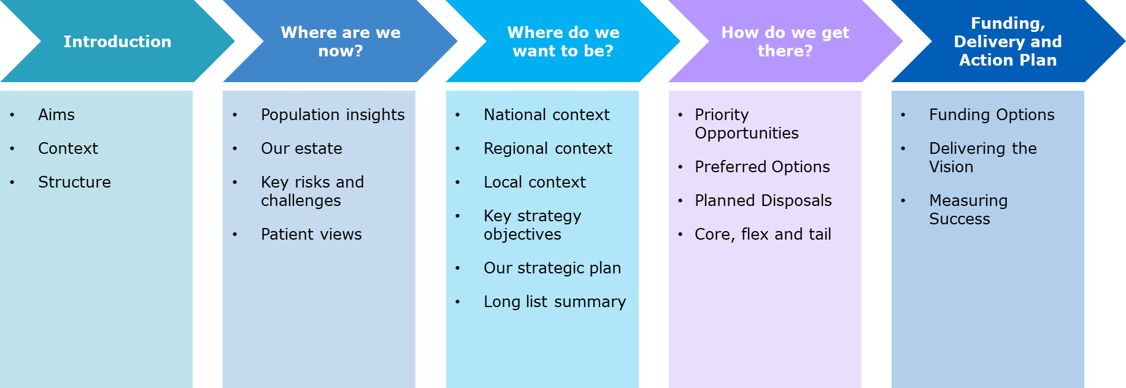
Introduction
Contents Roadmap
We have summarised the key sections of our Estate Strategy below, including covering the three main strands within the strategy of where are we now, where do we want to be and how do we get there. Key supporting information to build, develop and evidence our strategy is provided within the referenced appendices.
P.4

Slide 5
1. INTRODUCTION

Slide 6
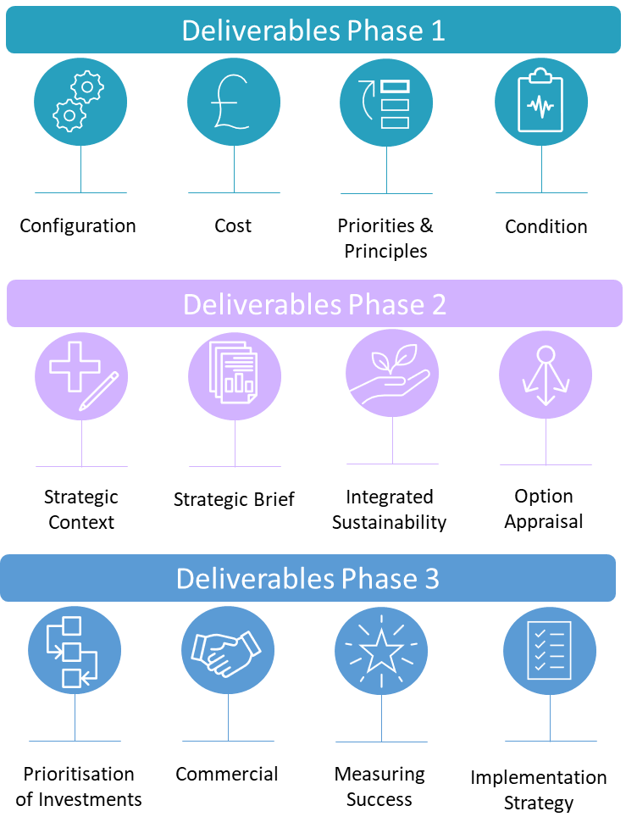
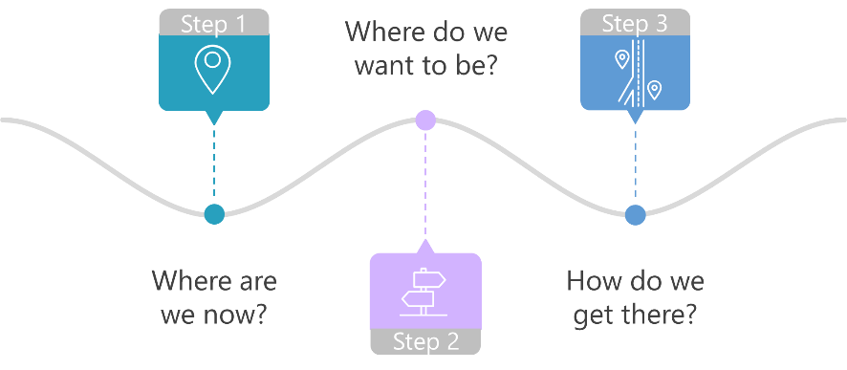
Introduction
Introduction
Our estate strategy aims to set the direction of travel for our estate development over the next 10 years to ensure that our estate enables our vision, values and strategic objectives, is safe and compliant, is fully utilised and agile, and meets our quality aspirations. This strategy is linked to our Trust enabling strategies and estate infrastructure planning within the wider system context in Hertfordshire and West Essex, Mid and South Essex, Suffolk and North East Essex, and Bedfordshire, Luton and Milton Keynes.
Our estate strategy has been developed through a series of workshops and stakeholder engagement to identify current estate risks and issues, and key estate strategy objectives to inform the development of estate options to support our vision to be the leading health and wellbeing service in the provision of mental health and community care.
This estate strategy is considered to be a ‘live document’ subject to regular review to ensure alignment with the Trust’s key objectives. It is structured under the following three key themes:
P.6

Slide 7
2. WHERE ARE WE NOW?

Slide 8
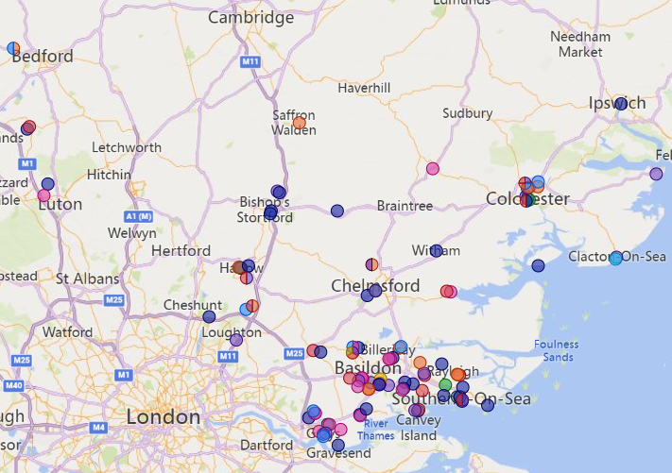
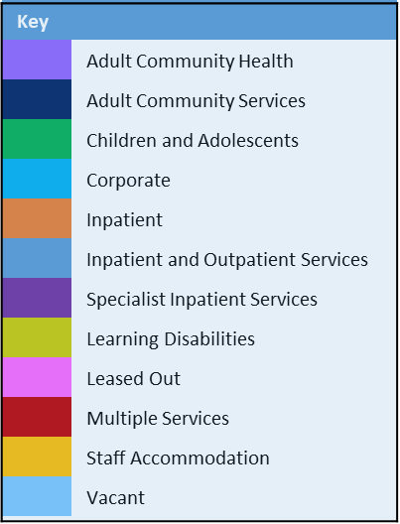
Where Are We Now?
Our Service Delivery Locations
EPUT provides community health, mental health, learning disability and social care services to over 3.2 million people across the East of England in Bedfordshire, Luton, Essex, Southend, Thurrock and Suffolk. Our services are delivered by more than 5,500 staff working across more than 200 sites. At any one time, we care for more than 100,000 people.
We are a key partner in four Integrated Care Systems (ICSs) - Hertfordshire and West Essex, Mid and South Essex, Suffolk and North East Essex, and Bedfordshire, Luton and Milton Keynes (providing some specialist services).
We work in partnership with Essex County Council, Thurrock Borough Council, Southend City Council and local district and borough councils. We also work closely with other providers of NHS services including GP practices, primary care networks, acute trusts, mental health and community trusts, voluntary, community and social enterprise organisation and independent sector providers.
Our place-based and trust wide services are delivered through the following care units:
Mid and South Essex Community Services
North East Essex Community Services
West Essex Community Services
Specialist Services
Urgent Care and Inpatient Services
Psychological Services
The map illustrates the locations for EPUT properties delivering services within the six care units. The majority of properties are clustered around the bulk of the population in South Essex.
The distribution of our services across the East of England
P.8

Slide 9
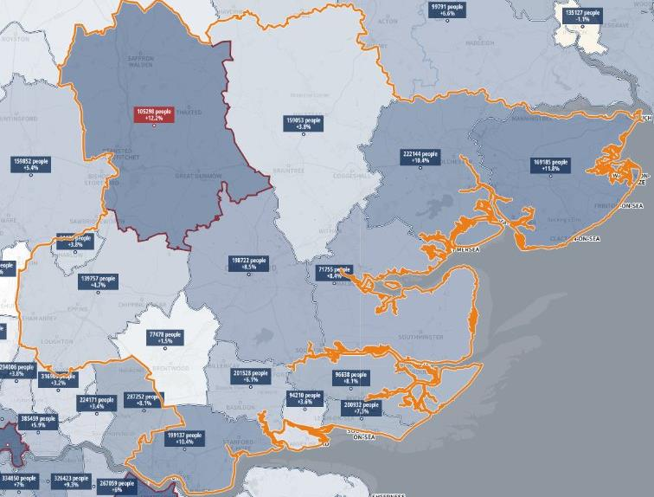
Where Are We Now?
Population and Demographic Impacts
Essex localities population growth from 2024 to 2037 (Source: SHAPE Atlas)
Our population and demographics have a significant bearing on service provision and estate requirements
Challenges
Our demand continues to increase. Our population is growing at one of the fastest rates in England, and our ageing population has increasingly complex health and social care needs. The population of Essex, Southend and Thurrock is forecast to grow by 2.9% between 2022 and 2027 with demand for mental health and community services expected to grow at a faster rate. The population over 65 is forecast to increase by 8.3% between 2022 and 2027, which is an extra 32,000 older adults. This is the largest relative rise of any age group, increasing the need for physical healthcare alongside mental health interventions. While forecast population growth among children and young people is unlikely to drive demand in the same way, recent national data show a significant increase in mental health referrals for children and young people.
105,298
+12.2%
159,053
+3.8%
222,144
+10.4%
169,185
+11.8%
198,722
+8.5%
71,755
+8.4%
139,757
+4.7%
Key Messages
The highest population growth (%) is expected to be in the northern region of West Essex.
The lowest population growth is expected to be across part of North Essex and South West Essex.
South Essex is more densely populated when compared to other areas of Essex.
77,478
+1.5%
201,528
+6.1%
96,638
+8.1%
94,210
+3.6%
200,932
+7.3%
199,137
+10.4%
P.9

Slide 10
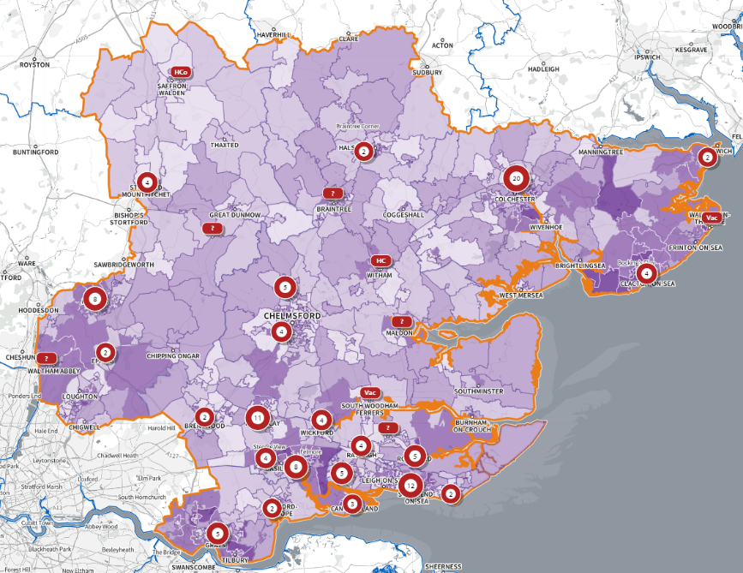
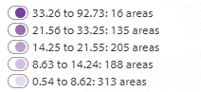
Where Are We Now?
Impact of Levels of Multiple Deprivation
Multiple deprivation prevalence (Source: SHAPE Atlas)
Some of our most deprived areas have limited access to healthcare facilities
Challenges
Deprivation has increased across our population, leading to significant health inequalities and disparity in health outcomes within vulnerable groups and often in the context of multi-generational need across families. The percentage of Essex residents living in the most deprived 20% of areas is amongst the highest in the East of England. EPUT serves an increasingly diverse population, and we need to continually adapt our services to meet our evolving population needs.
Key Messages
There are a number of areas of mild to moderate deprivation. These areas are particularly focused in West Essex (towards the Hertfordshire border), South West Essex and South East Essex, lower Mid Essex and pockets of eastern areas of North Essex.
Some areas of deprivation have limited access to healthcare facilities, especially in the eastern region of North Essex.
EPUT healthcare facilities are more densely localised to South Essex, when compared to the other areas of Essex.
This illustrates that there are areas that experience both significant economic and health access deprivation. This may be a particular issue as areas of economic deprivation are likely to have significant health needs.
Index of Multiple Deprivation (quintiles )
The colours represent the areas of deprivation. Darkest purple represents highest level of multiple deprivation
Graphic shows the number of EPUT healthcare facilities, overlaid on a Deprivation Index.
P.10

Slide 11
Where Are We Now?
Overview of Our Estate Data
EPUT services are provided from circa 150 properties across Bedfordshire, Luton, Essex, Southend, Thurrock and Suffolk, with a total size of 127,000sqm. A vast majority of the estate is older than 40 years and circa 34% of properties has poor energy performance which does not support the Trust’s net zero ambitions.
Age
Buildings older than 40 years is the measure used in ERIC as an indicator of the end of the life cycle, i.e. fitness for purpose relating to both condition (physical condition and statutory compliance) and functional suitability. 57% of EPUT’s estate is over 40 years old.
Cost
The cost to occupy a health facility over its useful life will exceed the original capital investment by a multiple of 5-10 depending on its use. The building costs analysed in this strategy are Rent, Service Charge and Business Rates only.
Energy Performance (EPC) Rating
EPCs indicate the energy efficiency of a property and include estimated energy costs as well as a summary of the property’s energy performance. Properties that have an EPC of E or below are classed as ‘substandard’ by regulations. 34% of EPUT’s properties have an EPC rating of E or below.
Partnership Working
40% of properties are located with partners. Sharing of properties with partners can help with improving integrated care and patient access, enhancing collaboration and resource sharing.
152 Properties
59% Freehold
Based on no. of buildings
127,000 sqm
Total size of estate
57% of estate is over 40 years old
74% of estate footprint is clinical
50% of estate is over 40 years old
706* Inpatient beds
34% of properties have an EPC rating of E or below
£157 m
Value of Freehold Estate (BLDG)
£8.8m total occupational costs (p.a)
800k total income received (p.a)
40% of Properties are located with partners
Key Messages
Majority of properties are freehold
Just over half of the estate is over 40 years old
Predominately old estate with poor energy performance
Adoption of partnership working across the estate
*without Epping beds
P.11

Slide 12
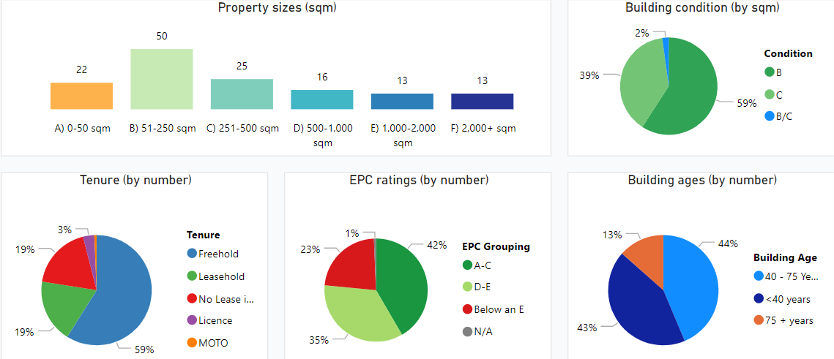
Where Are We Now?
Overview of Our Estate Data
Key Messages
We deliver many services from a large number of properties. A vast amount of these properties are under 250sqm, indicating small scale delivery across a large geography and number of sites
However, 85% of our total occupational costs (£8.8m p.a) are derived from 10 key properties
59% of properties are freehold with the main properties being Rochford Hospital, Thurrock Hospital and Linden Centre
Leasehold properties with the highest net occupational costs
P.12

Slide 13
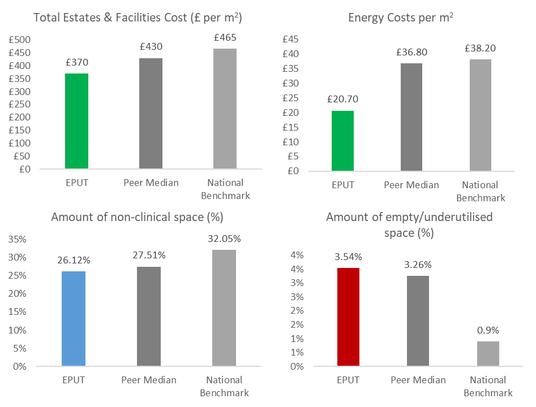
Where Are We Now?
Overview of Our Estate Data
An estate diagnostic was undertaken to provide a baseline reference for key estate condition and performance metrics and to identify key challenges and opportunities offered by the existing estate (source data: 2022/23 Estates Returns Information Collection (ERIC).
EPUT performance for key metrics compared to national benchmark and peer group medians is shown opposite (list of peer median organisations provided within Appendix 1).
Key highlights:
Our cost of estate occupancy (£ per m2) is ~14% lower than our peers, and ~20% lower than the national benchmark.
We are performing well against the Carter Benchmark of no more than 35% of non-clinical space; our performance is similar to peers, and better than national benchmark.
There is an opportunity to reduce the amount of our empty/under-utilised estate, which at c.3.54% is higher than the Carter benchmark of 2.5%; empty/underutilised space is similar to peers but significantly higher than national benchmark at c.0.9%.
Our energy costs per m2 ~ 44-46% below our peer median and national benchmark.
Performance better than national benchmark
Below national benchmark (no judgement whether more desirable)
Performance below national benchmark
Above national benchmark (no judgement whether more desirable)
The property data used throughout this report is from the EPUT Master spreadsheet 2024. The data used in the following graphs have been taken from the Model Health System 2022/2023 so the data, therefore, reflects slightly differently from the costs and percentages in the main summary

Slide 14
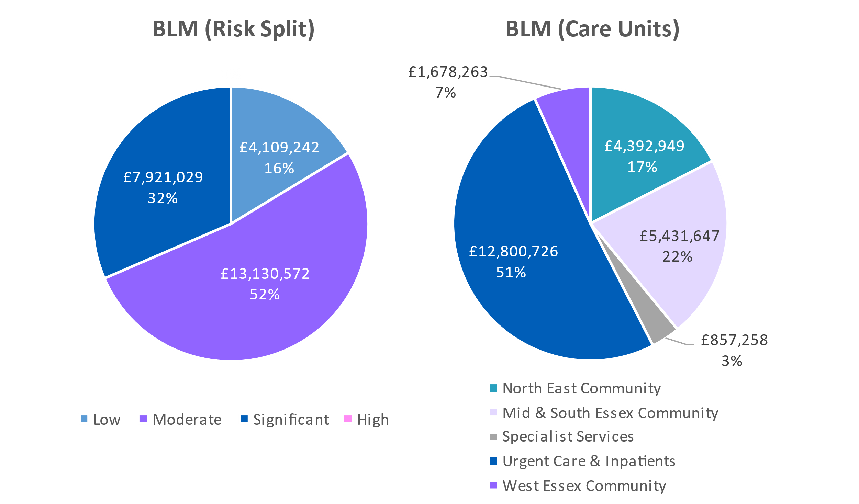
Where Are We Now?
Backlog Maintenance Across Our Estate
Critical Infrastructure Risk represents ~ 1/3 of our total BLM costs
Healthcare estate deteriorates over time and requires investment to ensure that service delivery remains safe and fit for purpose. A 2023 Six Facet Survey of 49 of EPUT’s freehold assets indicated (based on physical condition and statutory compliance) a total backlog maintenance (BLM) cost of £25,160,843*. While the majority of BLM costs are categorised as ‘moderate’, critical infrastructure risk represents 32% of total BLM costs.
Phrase | Definition
Low Risk | Should be addressed through agreed maintenance programmes or included in the later years of the estate improvement strategy
Moderate Risk | Should be addressed by close control and monitoring; can be effectively managed in the medium term so as not to cause undue concern to statutory enforcement bodies or risk to healthcare delivery or safety. These items require expenditure planning for the medium term.
Significant Risk | Require expenditure in the short term but should be effectively managed as a priority so as not to cause undue concern to statutory enforcement bodies or risk to healthcare delivery or safety.
High Risk | Must be addressed as an urgent priority in order to prevent catastrophic failure, major disruption to clinical services or deficiencies in safety liable to cause serious injury and/or prosecution.
Critical Infrastructure Risk represents c.32% of total BLM costs
Data source: 2023 Six Facet Survey of 49 EPUT freehold assets; *Year 0 (no uplift applied)
P.14

Slide 15
Where Are We Now?
Key Estate Risks and Challenges
Our estate is facing significant risks and challenges and severe limitations on expected future funding. Much of the current estate is not sustainable or viable in the long term. There are a number of associated estates risks (listed below, not in order of priority) which must be considered when prioritising future investment to support high quality service delivery for our patients and staff. Patient safety remains at the centre of delivering the strategy is behind every decision taken
Low investment & CDEL availability / affordability
01
Backlog Maintenance
04
Poor Therapeutic Environments
02
Affordability of creating a Net Zero estate
05
PFI Contract Expiry in 2033 (Clifton Lodge and Rawreth Court) and 2038 (Brockfield House)
Pace and alignment of ICS estate strategies
03
06
P.15

Slide 16
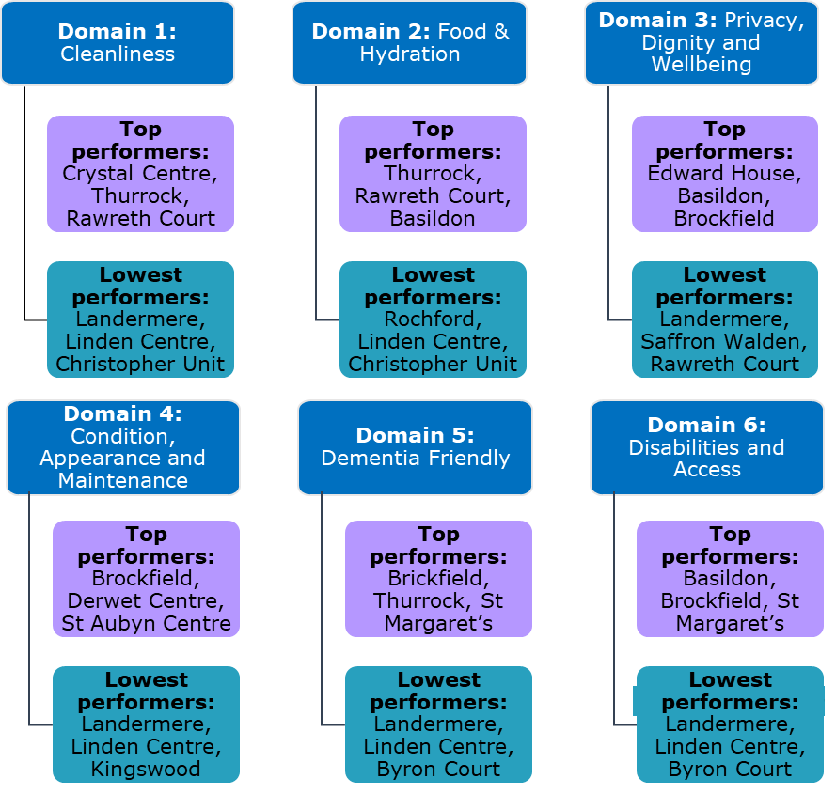
Where Are We Now?
Patient Views of Our Current Estate
PLACE Report Summary
The Patient Led Assessments of the Care Environment (PLACE) 2023 Report outlines the following 4 general themes and findings:
Patient assessors were impressed with the attractiveness and availability of recreational activities for patients, with many wards having games rooms, gyms and well kept outdoor spaces.
A key area for improvement is accessibility for those with disabilities and for those with visual impairments in particular.
By using colour effectively, we can aid patients orientation around our sites. e.g. doors and toilet seats are not the same colour as the walls and surrounding systems.
On the majority of sites, signs leading to the centre and car parking availability could be improved to make it easier for people to find our sites.
Action plans identifying and addressing the key issues in each of premises as part of the Trust programme of environmental improvements
Domain Performances
Overall Top Performers Overall Lowest Performers
1st
2nd
3rd
2nd
3rd
1st
Brockfield
Basildon
Thurrock
Landermere
Linden Centre
Byron Court

Slide 17
Estate Strategy 2024
3. WHERE DO WE WANT TO BE?

Slide 18
Where Do We Want To Be?
Strategic Context - Overview
The development of our estate strategy cannot be viewed in isolation. This section considers the most pertinent national, regional, and Trust-wide priorities with which our estate strategy must align to support delivery of our vision and estate strategy objectives.
National Policies and Strategies
NHS Long Term Plan - Mental Health
NHS Mental Health Implementation Plan
Naylor Review
Fuller Report
Delivering a ‘Net Zero National Health Service
NHS Long Term Workforce Plan
Regional
Strategies
Hertfordshire and West Essex Estate Infrastructure Estate Strategy
Suffolk and North East Essex Estate Infrastructure Strategy
Mid and South Essex Estate Infrastructure Strategy
Bedfordshire, Luton and Milton Keynes Infrastructure Strategy
EPUT Strategies and Plans
Quality of Care Strategy
Green Plan
Digital Strategy
Social Impact Strategy
People and Education Strategy
Research Strategy
P.18

Slide 19
Where Do We Want To Be?
Strategic Context - National
The NHS Long Term Plan
The NHS Long Term Plan committed significant investment in mental health services to support an ambitious transformation programme. It also set out how services will be integrated, and community-based services will be expanded, to support more people at home. The new learning disability and autism standards must also be implemented by all trusts by 2023/24.
While the population is increasing, there has also been a record number of people that require NHS mental health services and referrals. However, national capital allocations have largely been prioritised towards acute settings with underinvestment in mental health and community services. This is a particular issue for trusts aiming to redevelop their estates to improve the quality of care offered to patients, reduce the mental health backlog and improve efficiency. Within this context, alignment with national, regional and local strategies needs to be considered within the estate strategy.
The priorities for the NHS Mental Health Long Term Plan include:
Ensuring the population have quicker access to treatment
Ensuring adults and children have access to mental health crisis care at any time
Ensuring mothers and partners are offered mental health support during and post-pregnancy
Improving access for children and young people through schools and colleges
Developing hospital and community services across the country
P.19

Slide 20
Where Do We Want To Be?
Strategic Context - National
The government, NHS and other governing bodies have developed overarching strategies and plans to guide the delivery of health services across England. Those that are particularly relevant to EPUT and the development of this Estate Strategy are briefly summarised below.
NHS People Plan
Sets out plans to make the NHS the best place work and develop a positive, inclusive, individualised, leadership culture, with a clear focus on improvement and advancing quality and inclusion.
NHS Mental Health Implementation Plan
Sets out specific commitments to significantly expand access to psychological therapies, perinatal, and children and young people’s mental health services and transform community mental health delivery, including greater support for evidence based pharmacological treatments.
Community Mental Health Framework
Describes a new model for a place-based community mental health model, including personalised condition management, medicines management, individualised recovery, and a more integrated approach to joined-up care.
Draft Mental Health Bill
Health and Care Act 2022
The Bill will reform the current Mental Health Act (1983); introducing new requirements to ensure service users’ views and choices are respected, that the act’s powers are used in the least restrictive way, that admission supports recovery, and that service users are viewed as individuals.
Places stronger emphasis on the integration of health and care services. It has established ICBs and ICPs, and requires ICPs to publish Integrated Care Strategies and ICBs to agree Five Year Forward Plans with their partner NHS providers. It sets the triple aim for the NHS of health and wellbeing, quality of services, and efficiency and sustainability.
P.20

Slide 21
Where Do We Want To Be?
Strategic Context - National
The Naylor Review
There is a large disparity and variation across the NHS estate, with nearly 20% of hospital trust estate predating the formation of the NHS (1948) and ~ £5bn in backlog maintenance. The Naylor Review details these issues and presents 17 recommendations and outlines a vision of the future for the NHS.
Recommendations include:
As a minimum the department of health should provide assurance to STPs (now ICSs) that any sale receipts from locally owned assets will not be recovered centrally provided the disposal agrees with ICS plans;
ICSs should develop affordable estates and infrastructure plans;
Land vacated by the NHS should be prioritised for the development of residential homes for NHS staff where there is a need; and
Substantial investment is needed to deliver service transformation in well evidenced ICS plans.
This Estate Strategy aligns with the ICS to ensure the recommendations from the Naylor Review are achieved where possible.
The Fuller Stocktake Report
Primary care faces numerous challenges which include high demand and inadequate access to urgent care. Built on this, the Fuller Stocktake Report presents a new vision for integrating primary care, and improving the access, experience and outcomes for communities. The key main findings and vision includes:
This vision requires a greater focus on estates data and better infrastructure. This includes investment, time, capacity and a supportive leadership culture.
Building integrated teams in every neighbourhood
Improving same-day access for urgent care
Creating the national environment to support locally driven change
Hard-wiring the system to support change
P.21

Slide 22
Where Do We Want To Be?
Strategic Context - National
Carter Report
The Carter Report was developed by Lord Carter, 2016, and details how efficiencies can be achieved across the NHS, specifically focused on “unwarranted variation”.
Key findings from the review:
Identified £5 billion of unwarranted variation across various functions, including estates and facilities
Identified £700 million of potential savings in procurement
In terms of estates and facilities, the following recommendations ensure that resources are used in a cost-effective manner:
Delivering a ‘Net Zero’ National Health Service
The NHS aims to deliver the world’s first net zero health service, responsive to health emergencies brought about by climate change. Two clear targets have now been developed:
For emissions we control directly, net zero by 2040, with an ambition to reach an 80% reduction by 2028 to 2032; and
For the emissions we can influence, net zero by 2045, with an ambition to reach an 80% reduction by 2036 and 2039.
The plan included estates as one of the areas where direct intervention can be taken to reduce emissions.
Refer to page 33 for more information on EPUT’s Green Plan to meet these targets.
Upgrading Buildings
LED lighting, HVAC systems, hot water, insulation
Optimising Usage
Real time monitoring
Onsite Energy Generation
Heat pumps, renewable resources
National Electricity Decarbonisation
Converting to 100% renewable energy
Trusts should operate at or above the benchmarks agreed by NHS Improvement for the operational management of their estates and facilities functions; with all trusts having a plan to operate with a maximum of 35% of non-clinical floor space and 2.5% of unoccupied or under-used space
Trusts should rationalise their corporate and administrative functions to ensure their costs do not exceed 6% of their income (or have plans in place for shared service consolidation with, or outsourcing to, other providers)
P.22

Slide 23
Where Do We Want To Be?
Strategic Context - National
NHS Long Term Workforce Plan
The NHS Long Term Workforce Plan was published on 30 June 2023. It sets out how the NHS will address existing and future workforce challenges by recruiting and retaining thousands more staff over a 15-year period, and working in new ways to improve staff experience and patient care.
Commissioned and accepted by the government, it provides a costed plan for how the NHS will develop to meet existing and future demand and challenges, and support population health and wellbeing. Over £2.4 billion has been committed to fund additional education and training places over the next five years, on top of existing funding commitments.
The plan sets out the strategic direction over the long term as well as short- to medium-term actions to be undertaken locally, regionally and nationally. Those actions fall into three priority areas:
Train: Substantially growing the number of doctors, nurses, allied health professionals and support staff. This is underpinned by a £2.4 billion funding commitment.
Retain: A renewed focus and major drive on retention, with better opportunities for career development and improved flexible working options. This comes alongside reforms to the pension scheme, with an aim to retain 130,000 staff working in the NHS for longer.
Reform: Working differently and delivering training in new ways. Advances in technology and treatments will be explored and implemented to help the NHS modernise and meet future requirements.
While it is a national plan, it allows for priority decisions to be taken at system and local level. There is also a commitment for it to be an iterative rather than ‘one-off plan’, with further versions developed and published on a more regular basis.
The plan aims to increase the total number of NHS staff through an unprecedented expansion in recruitment and significant improvement in retention, so the NHS keeps more existing staff in post. Routes into the NHS will change through the development of apprenticeships and reform of medical education and training.
The plan also aims to deliver productivity improvements through making the most effective use of emerging technologies such as artificial intelligence. It also signals a shift from reliance on international recruitment to a largely domestic recruitment model.
Train
Retain
Reform
P.23

Slide 24
Where Do We Want To Be?
Strategic Context – Regional (Mid and South Essex ICS)
The Mid and South Essex ICS Estate Strategy highlights the ICB’s ambition to develop its infrastructure to support the transformation of their services. This ambition extends to mental health and community services, a primary component of EPUT. The EPUT Estate Strategy has been aligned to the ICS future direction for infrastructure (below) and the adjacent core principles.
The ICS Infrastructure Core Principles
Utilise our estate as an enabler to reduce our costs and create efficiencies
Build an integrated and collaborative approach to infrastructure decision-making
Create a strategy that is owned and supported by all system stakeholders
Use data and insight to drive our priorities and decision-making
Optimise use of our core estate
Have a prioritised approach to infrastructure provision
Create efficiencies
Integrate sustainability into decision-making and processes
Focus on infrastructure which supports prevention and areas of deprivation
Focus on infrastructure which supports prevention and areas of deprivation
Drive infrastructure transformation from our Places
Reduce inequalities in health outcomes
Be creative and innovative
Mental Health
Community
Accessibility and maximising
utilisation of it are key
Priorities
______________________________
Cultural and physical shift to better use of existing estate
Improve accessibility to outpatient facilities
Achieving consistency in estate quality of our outpatient estate.
Clear mapping of our estate to understand the optimum location of mental health services driven by colocation, workforce and accessibility
Ensuring we maximise
opportunities to integrate
services at a local level
________________________________
High proportion of NHS Property Services estate needs to be better utilised
Plan for utilisation of void at Brentwood Hospital PFI which represents nearly 40% of the NHSPS void space
Initiate asset strategies for our multi-occupied health centres
Use our community estate to bring services closer to home and integrate our system services
Create flexibility around use of estate
Strategic planning around tail estate
P.24

Slide 25
Where Do We Want To Be?
Strategic Context – Regional (Hertfordshire and West Essex ICS)
The below outlines the key Hertfordshire and West Essex ICB objectives for infrastructure. These are categorised into 3 key components: population health, quality and efficiency, and are consistent with the key objectives of our Estate Strategy.
POPULATION HEALTH | QUALITY | EFFICIENCY
Address health inequalities by providing good quality facilities in areas of greater deprivation, noting that HWE is generally below the national average Planning for population growth and demographic trends and forecasts to ensure appropriate care Providing services having regard to accessibility, notable public transport Facilitate Integrated Service Delivery in Places and Neighbourhoods Support and encourage co-location of multi-disciplinary teams | Facilitate high quality service delivery. The infrastructure to support digital service delivery Create the environment to recruit and retain staff Create the environment for training and development | Optimise the use of the existing good quality estate and premises, offering extended hours and additional services Rationalise spaces such as multiple reception areas, waiting areas, staff areas and administration spaces Disinvest from assets classified as ‘tail’ to reduce the footprint where running costs are non-efficient Work towards an environmentally net carbon zero and financially sustainable estate
P.25

Slide 26
Where Do We Want To Be?
Strategic Context – Regional (Suffolk and North East Essex ICS)
The below outlines the key estates objectives and priorities for Suffolk and North East Essex ICB. The ICB’s ambition for the population is to have ‘an integrated estate that allows the delivery of care at the right time, in the right way, in the right place, by the right person’. The objectives below are consistent with the objectives of our Estate Strategy.
Estate Planning
Primary Care Estates Strategies
Future Systems
Developing Centres of Excellence
Meeting Future Demand
Ownership and Management
To develop effective and efficient estate management arrangements through increased coordination and collaboration between individual Estates and Facilities Management (EFM) teams and consolidated estate ownership within the ICB area.
To have a consistent but appropriate and proportionate methodology for collecting, reporting and presenting data relevant to the system estate.
To identify opportunities to address short, medium and long-term capacity issues through estate development, optimisation and utilisation.
To prioritise primary care estate development to support the delivery of services within the community.
To work as a system to ensure the system infrastructure underpins new ways of working.
To work alongside and ensure strategies are aligned with other key enablers including workforce planning and digital.
To align estate intelligence and planning to activity, performance, and finance planning, to create a sustainable estate to meet health population needs.
To support the development of the best possible estate in the correct locations for the delivery of clinical services.
Work with the local authorities to understand, plan for and mitigate the proposed housing growth planned to ensure health care provision is adequate for increased population.
To work to secure adequate and appropriate mitigations from housing developments to support the development and expansion of health and wellbeing services to meet the growth in population.
To work as a system to ensure assets are owned by the most appropriate system partner for the benefit of the delivery of patient care.
P.26

Slide 27
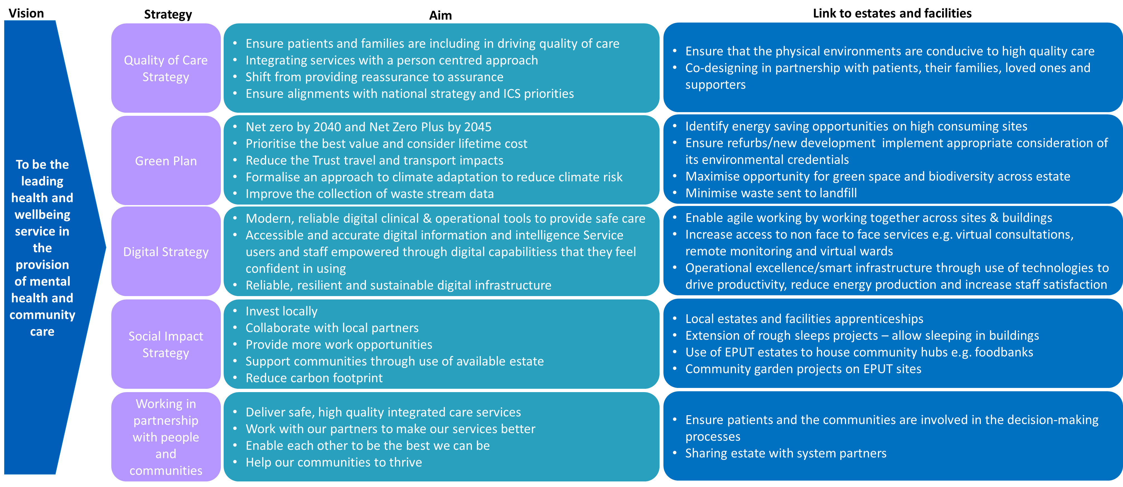
Where Do We Want To Be?
Strategic Context - Local
High interdependency of key enabling Trust strategies and estates
There are strong interdependencies between several of our key enabling strategies and our estates and facilities. Further detail on these strategies and how they link to estates and facilities is provided below.
P.27

Slide 28
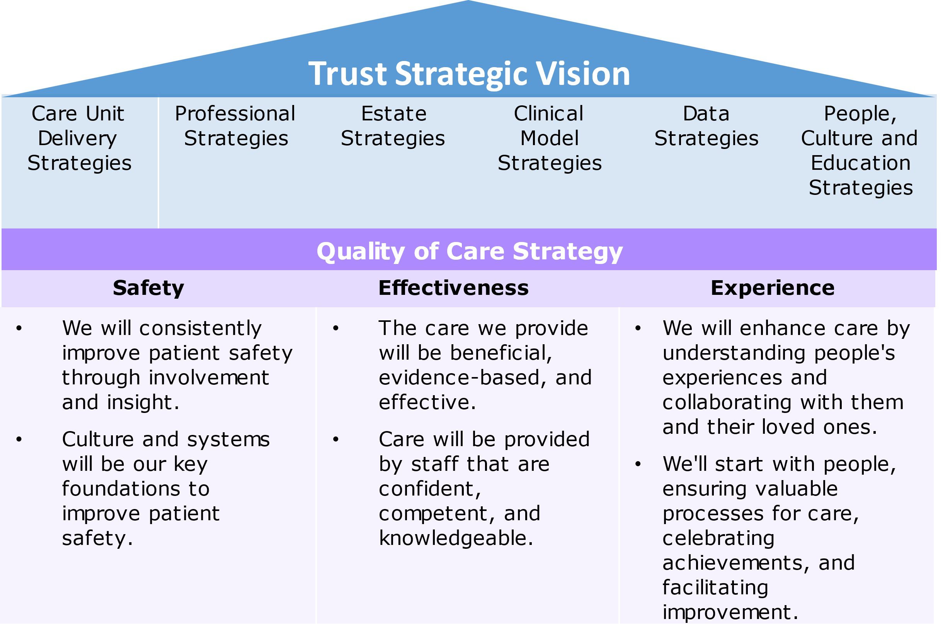
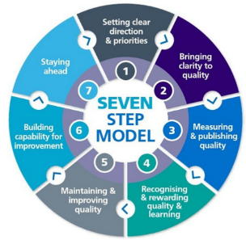
Where Do We Want To Be?
Strategic Context - Local
Our Quality of Care Strategy
The Quality of Care Strategy supports the significance of safety, effectiveness and experience, building on the previous strategies developed by the Trust.
The intention of this strategy is to outline the importance of:
Collaboration to ensure that patients and families are included in driving the quality of care.
Improving the approach to care.
Integrating services with a person-centred and collegiate approach.
Shifting from providing reassurance to assurance.
Ensuring there is constant alignment with national strategies and ICS priorities.
As mentioned in the strategy, EPUT will use the 7 NHS guiding principles of delivering quality care when developing the delivery plan:
Strategic delivery success measures:
Year 1: Establish baseline data
Year 2: Benchmark against ourselves and incrementally improve on year 1 baseline setting
Year 3: Benchmark against ourselves and incrementally improve on year 2 baseline setting
Qualitative evaluation
Key Messages – Link to Estates and Facilities
Ensure that the physical environment is conducive to high quality care
Co-designing in partnership with patients, their families loved ones and supporters
P.28

Slide 29
Where Do We Want To Be?
Strategic Context - Local
Trauma-Informed Care
Our Strategic Plan 2023 – 2028 emphasises the Trust’s mission to introduce trauma-informed care and to be a psychologically-informed organisation. This specifically aligns with the Plan’s key strategic objective to deliver safe, high-quality, integrated care services and empowering the service users, families and carers. Plans for the Care Unit include:
Increase continuity of care
Empower service users have a choice in decisions about their care and recovery goals
Work with families and support networks to involve them in trauma-informed approaches
Upskill staff in trauma-informed care approaches
As part of this initiative, EPUT is introducing a Clinical Associate in Psychology (CAP) role to strengthen their psychological workforce. EPUT are the only NHS Trust to hold a main provider role for delivering CAPs training*.
This Infrastructure Estates Strategy is aligned with the principles of trauma-informed care and provisions need to be made where possible.
Key Message – Link to Estates and Facilities
Enhance the quality of care provided via co-designed modern, safe, fit for purpose environments that maximise positive experiences for patients
*In partnership with the University of Essex
P.29

Slide 30
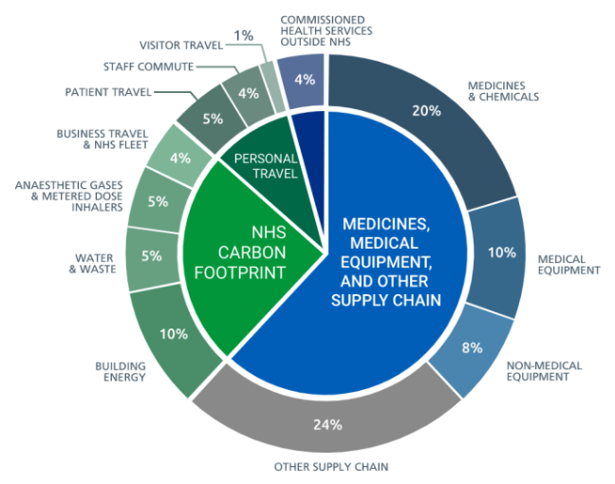
Where Do We Want To Be?
Strategic Context – Local
Our Green Plan
According to the World Health Organisation, the direct cost of climate change to the global healthcare industry is predicted to be between US$2-4 billion per year by 2030, with an additional 250,000 deaths per year worldwide.
As seen below, in 2020, the NHS was responsible for 4% of England’s overall carbon footprint, with 24.9m tonnes of carbon dioxide equivalents (tCO2e).
The current Green Plan (2021), establishes our carbon footprint and sets out actions to improve sustainability within the Trust, to ensure we meet all national and local legislative guidelines. The Green Plan was developed to have measurable targets and the areas of focus align with the 10 assessment areas in the Sustainable Development Assessment Tool (SDAT), a tool for organisations to monitor their impact and measure progress. The next update to EPUT’s Green Plan will move away from the SDAT use and align more with the ‘Delivering a net zero national health service’ guidance. Resources consumed by the Trust contribute towards our carbon footprint and wider environmental impact. We can reduce the environmental impact associated with our consumption by either a) reducing our absolute consumption or b) sourcing sustainable resources.
2020 NHS Carbon Footprint Plus – 24.9 mtCO2e
Key Messages – Link to Estates and Facilities
Asset management and utilities:
Perform energy audits of high-consuming sites to identify energy and waste saving opportunities
Develop site-specific energy strategies
Capital projects:
Put the correct processes in place such that any major refurbishment or new development can be implemented with the appropriate consideration of its environmental credentials
Green space and biodiversity:
Maximise the opportunity potential of green space and biodiversity across our estate.
Sustainable use of resources:
Minimise waste sent to landfill
P.30

Slide 31
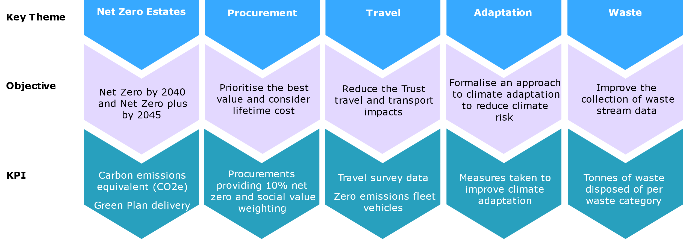
Where Do We Want To Be?
Strategic Context – Local
Our Green Plan – Estates Integrated Sustainability
Shown below are the key sustainability themes, and associated objectives, that we prioritising within their estate. The KPIs were developed working together with the EPUT sustainability manager to align with the Trust’s future goals and NHS net zero targets. Integrating sustainability into estate decisions can reduce costs and move the Trust closer to a net zero estate.

Slide 32
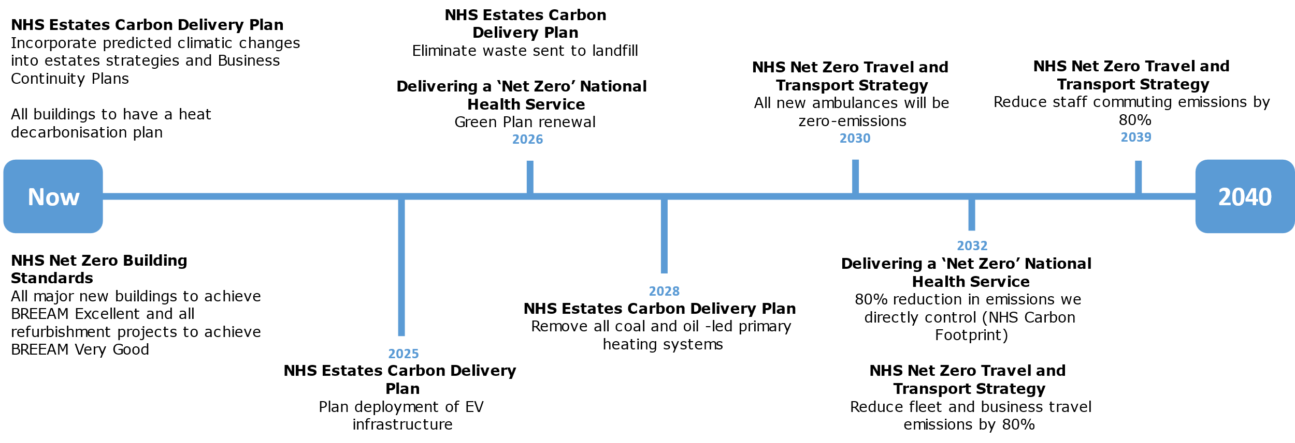
Where Do We Want To Be?
Strategic Context – Local
This timeline below collates all the net zero benchmarks outlined in all the current NHS guidance. Creating a roadmap of targets for EPUT to work towards. EPUT must ensure they are considering these goals to avoid barriers in the future. Ensuring buildings have sufficient infrastructure to accommodate an electric fleet and considering climate risks and transport connections when considering new sites.

Slide 33
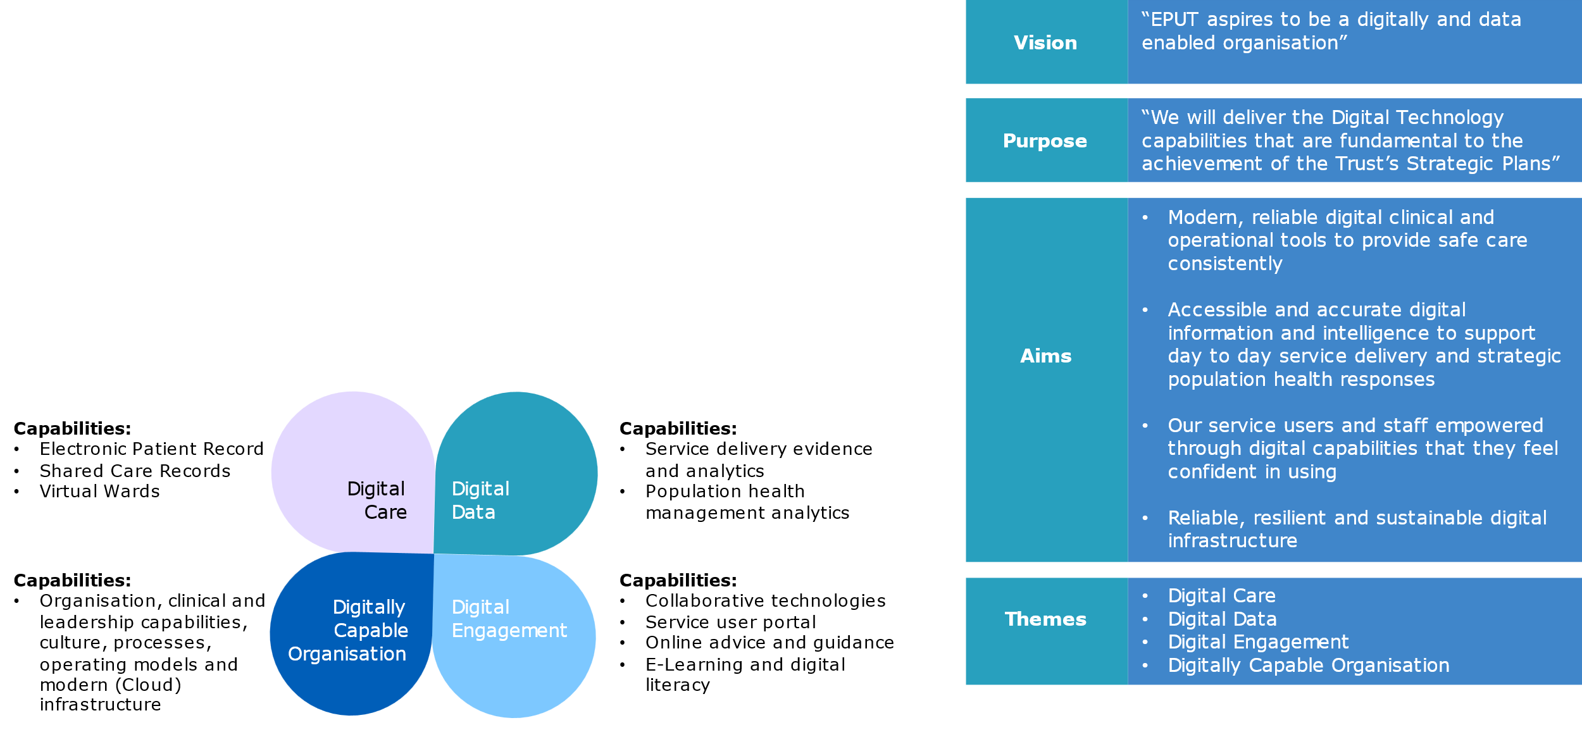
Where Do We Want To Be?
Strategic Context – Local
Our Digital Strategy
The EPUT Digital Strategic Plan (2023 – 2029) is an ambitious plan that sets out how the Trust will transform the quality and safety of care through creating a digitally capable organisation. Successful implementation of the plan is dependent on a shift in culture, continuous transformation and prioritised investment. The Digital Strategy outlines the capabilities required to achieve the Trust’s aims and priorities:
Digital Care: replace existing clinical systems with modern technology
Digital Data: ensure that data is recorded on a centralised database to ensure consistency
Digital Engagement: build digital services, capabilities and communication between services users, staff and partners
Digitally Capable Organisation: ensure infrastructure, estate and literacy is able to support digital capabilities
P.33

Slide 34
Where Do We Want To Be?
Strategic Context – Local
Our Digital Strategy – link to estates and facilities
There are strong links and dependencies between Estates, Digital and the People Team. For example, there are often large IT contracts that may impact the cost of infrastructure plans, and this needs to be considered.
In order to avoid the inefficient use of resources, the teams should work in constant collaboration – this may include establishing a Change Management Board that consists of representatives from each team. The intention of this Board is to review Business Cases and ‘big picture’ strategies to ensure that they are aligned and correctly resourced before presentation to the Capital Projects Group.
Key Messages – Link to Estates and Facilities
Digital infrastructure: ensure the digital infrastructure is robust to support the safety and quality of care. This may require investment.
One single system: Unified Electronic Patient Record (UEPR) across mental health and community settings and acute partners in Mid and South Essex, replacing our current clinical systems by 2026.
Agile working: work closely together in a flexible way across sites and buildings.
Data-Driven: require data guided by the Data Strategy and with a move to “Cloud” based solutions and storage.
Data Driven decisions: effective data to drive estates and facilities.
Digitally empowered patients: aligned with the anchor strategy, there is an increasing focus for patients to be more involved in their treatment. In terms of digital, this includes provision of a Service User Portal; online advice and guidance; and e-Learning and digital literacy programs.
Operational excellence/smart infrastructure: use technology to drive productivity, reduce energy consumption, increase patient and staff satisfaction.
Hospital without walls: increase use of different for service users to access non-face-to-face services (e.g. virtual consultations, remote monitoring, virtual wards).
Estates
People
Digital
P.34

Slide 35
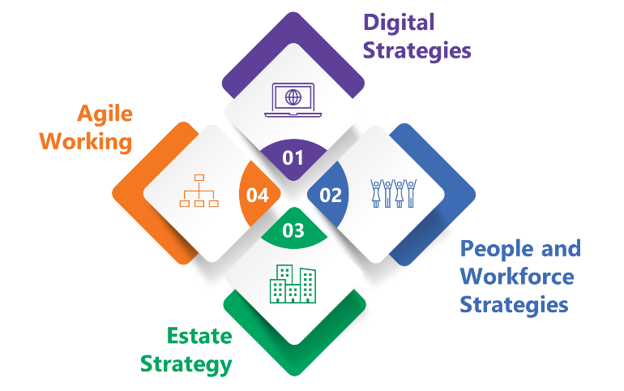
Where Do We Want To Be?
Agile Working
Our continued development of agile working principles should consider an evidence-based approach
NHS organisations are consistently reviewing how to enhance the efficiency and effectiveness of their clinical and non-clinical space to increase flexibility and resilience. Working patterns and standards post-pandemic are continuously evolving and this has accelerated the need for modern, flexible space to support activities – it may be less than before, and it may be in different locations.
The pandemic amplified several trends in the workplace including the growth of a dispersed workforce and the proliferation of digital engagement. This is therefore creating an emerging work environment that promotes agility and growth through a mix of on-site and remote employees.
We need to therefore consider workforce and working practises within the context of our estate redevelopment plans. This needs to be driven by an evidence based approach, reflecting changing working practises and linked to technological advances, and on a site by site basis. As an example, any potential redevelopment or refiguration of the Lodge will be pivotal in the adaptation and integration of agile working practises across the Trust.
Key Messages – Link to Estates and Facilities
To support a fit for purpose estate, guided by the strategic analysis of our estate through the Core, Flex and Tail Model we have adopted, we must ensure alignment and integration of our supporting strategies within digital, estate strategy and people and workforce strategies.
The Strategy recognises the importance of a future ready infrastructure and an estate that not only adapts to agile working but one that helps to drive innovation and collaborative working including virtual organisation, shared facilities and flexible workspaces whether in Trust or partner properties.
P.35

Slide 36
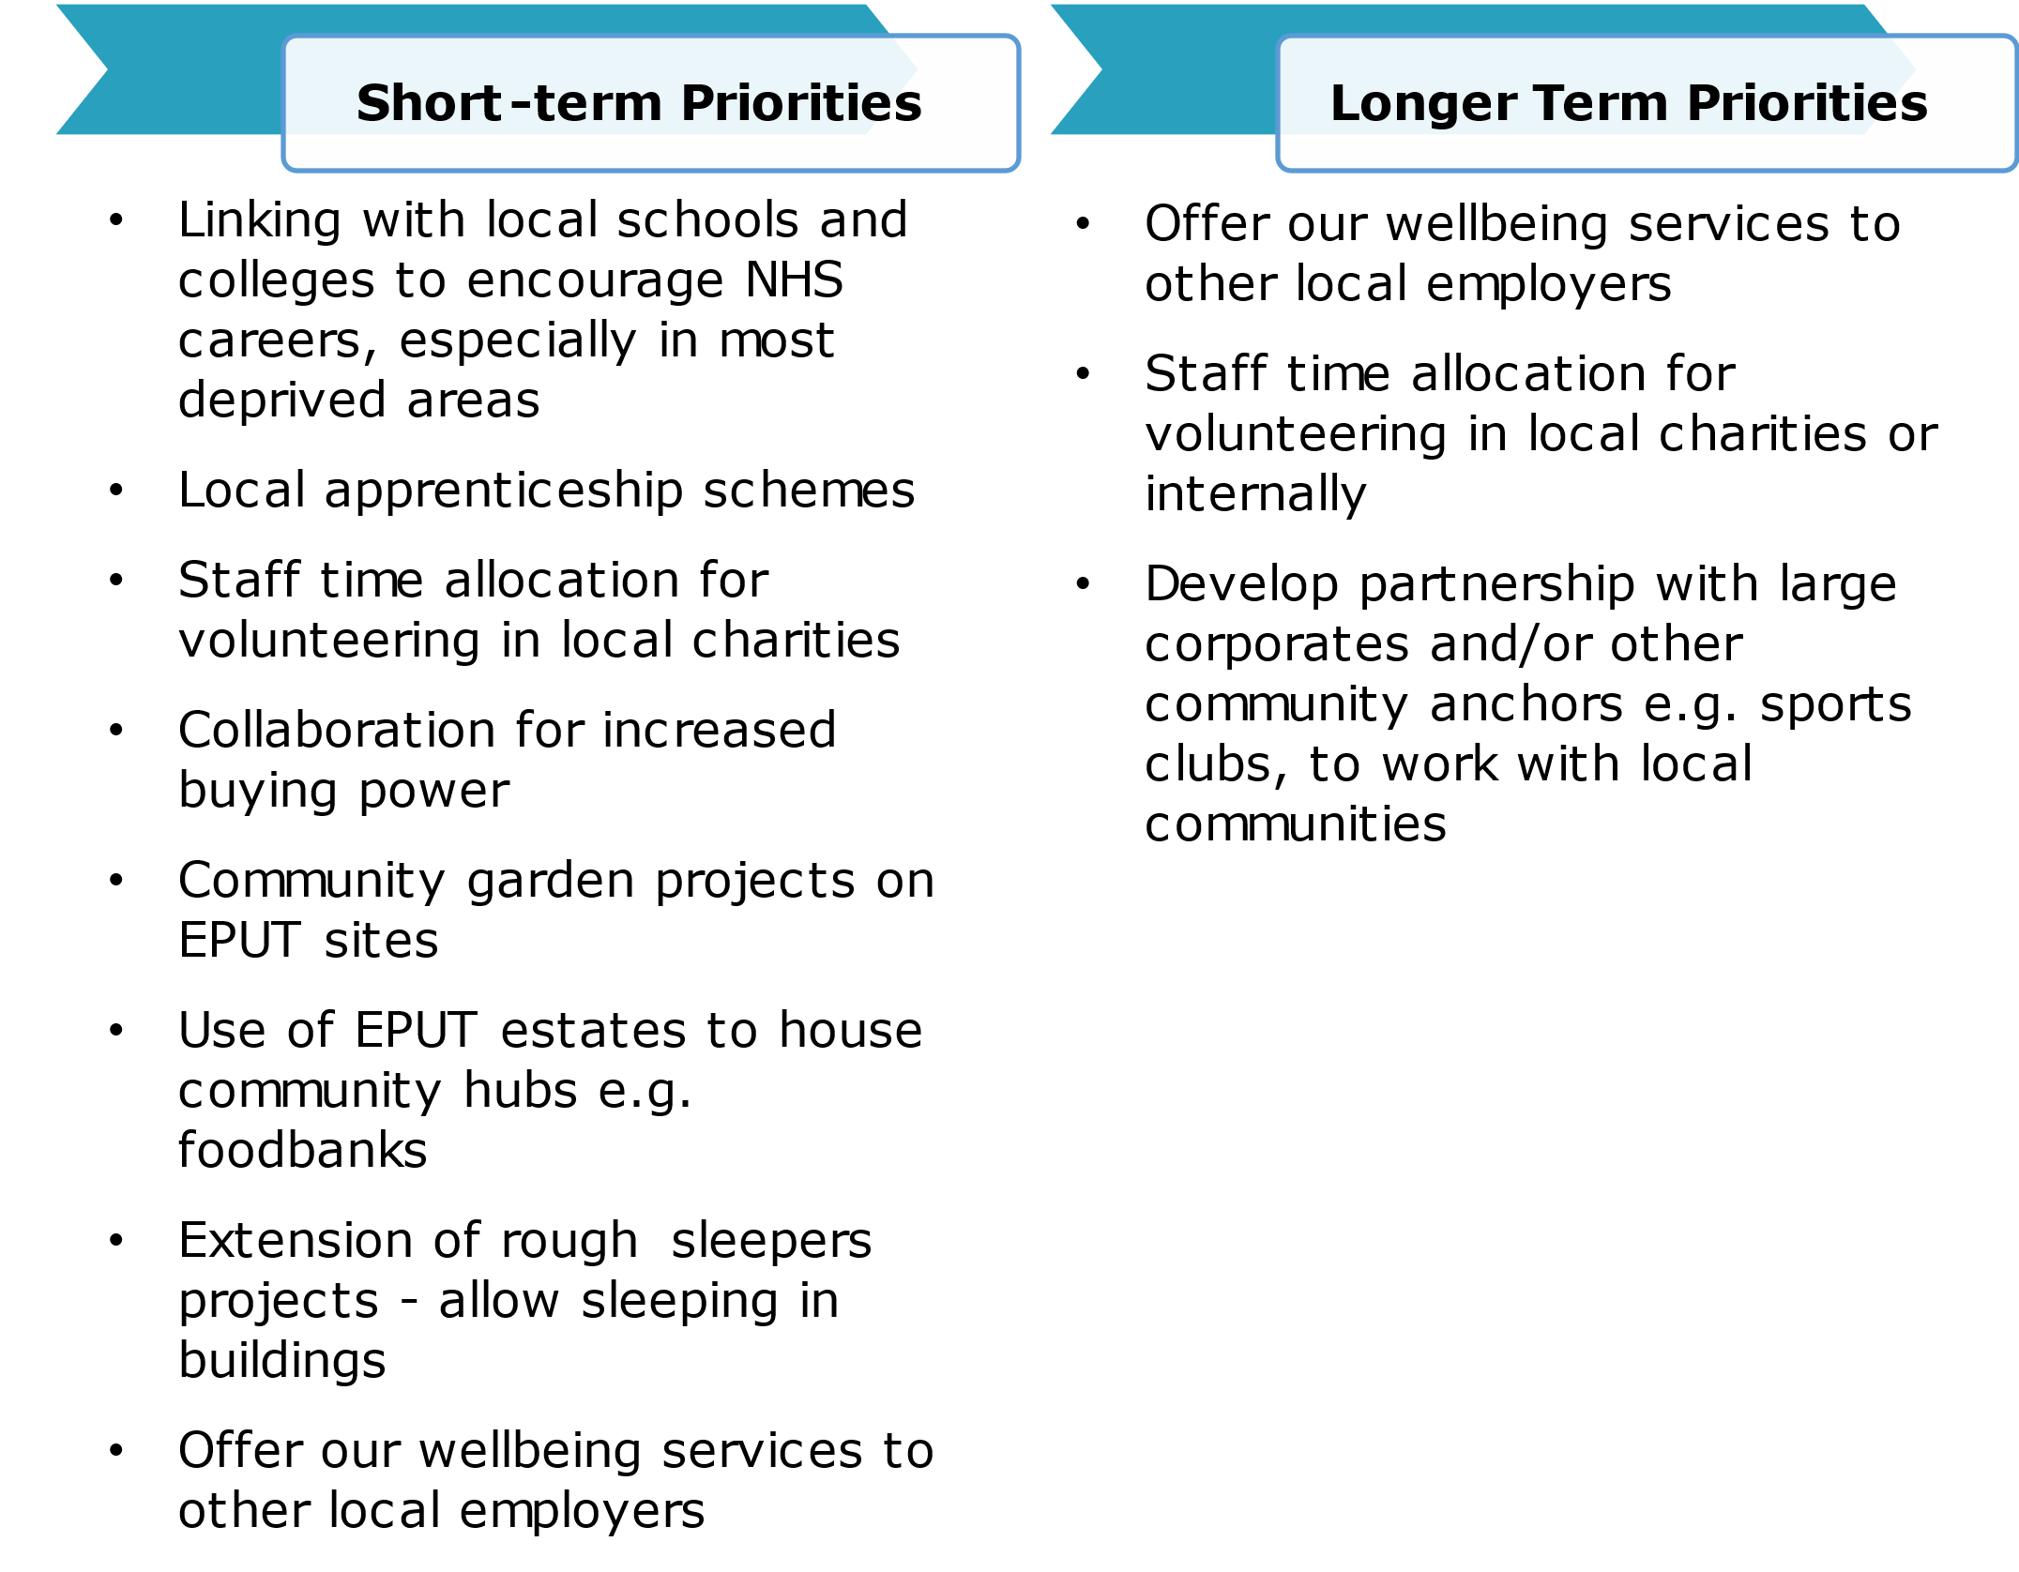
Where Do We Want To Be?
Strategic Context – Local
Our Social Impact Strategy
Position EPUT has a community enabler
Our Social Impact Strategy acts as the anchor strategy for the Trust and directly supports the delivery of the strategic objectives in the Strategic Plan. This Strategy particularly sets out how EPUT will help communities to thrive and how best to support the local population. In addition, the Strategy aligns with the operating principles of the three Essex ICB Anchor Programmes and the pan-Essex Programme.
Focusing on delivering maximum social impact is in direct alignment with caring for our communities, empowering our colleagues to innovate, and learning what works and what does not
Key Messages – Link to Estates and Facilities
Delivery of local estates and facilities apprenticeships
Extension of rough sleeps projects – allow sleeping in buildings
Use of EPUT estates to house community hubs e.g. foodbanks
Community garden projects on EPUT sites
P.36

Slide 37
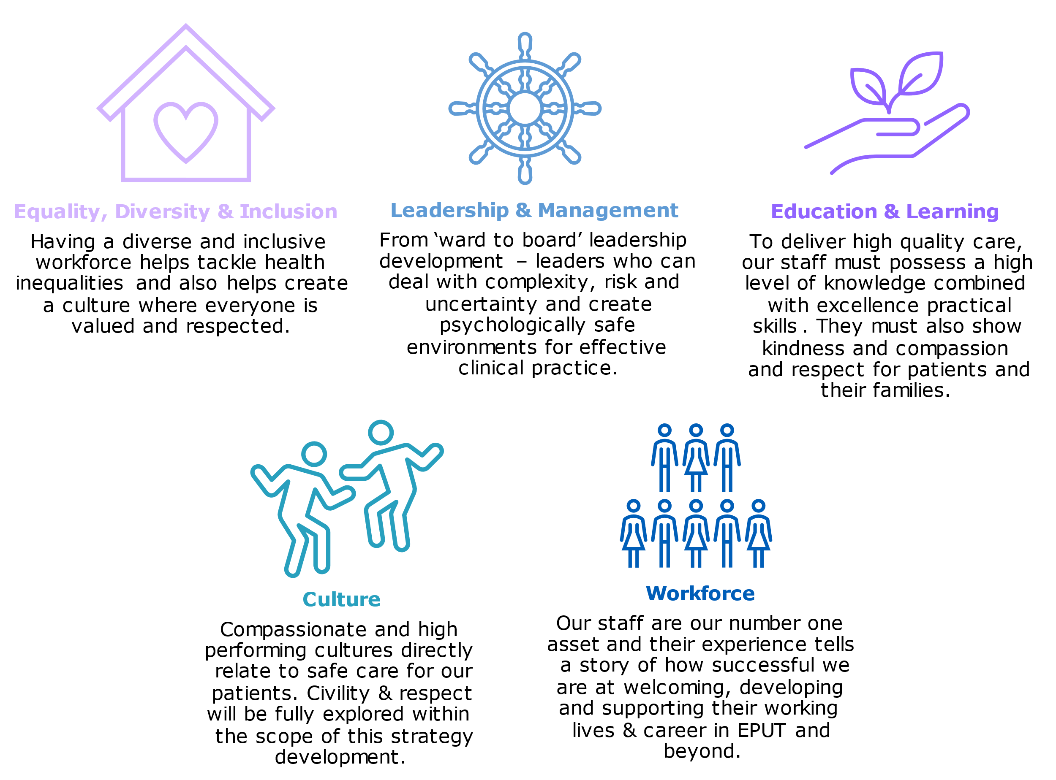
Where Do We Want To Be?
Strategic Context – Local
Working in partnership with people and communities
Our People and Education Strategy was developed in line with the NHS Long Term Plan and its particular focus to train, retain and reform the workforce. The Operating Model extends across the EPUT Care Units and comprises 6 Operational Care Units: HR Business Partnering, Employee Relations, Workforce, Education and Leaning, Medical Staffing, Organisational Development and Recruitment. Each of these Care Units require adequate, agile and robust infrastructure to support their objectives. The pillars of the People and Education Strategy include:
Key Messages – Link to Estates and Facilities
Involving patients and communities in the decision-making process
Sharing estate with system partners
Need to implement agile working policy
P.37

Slide 38
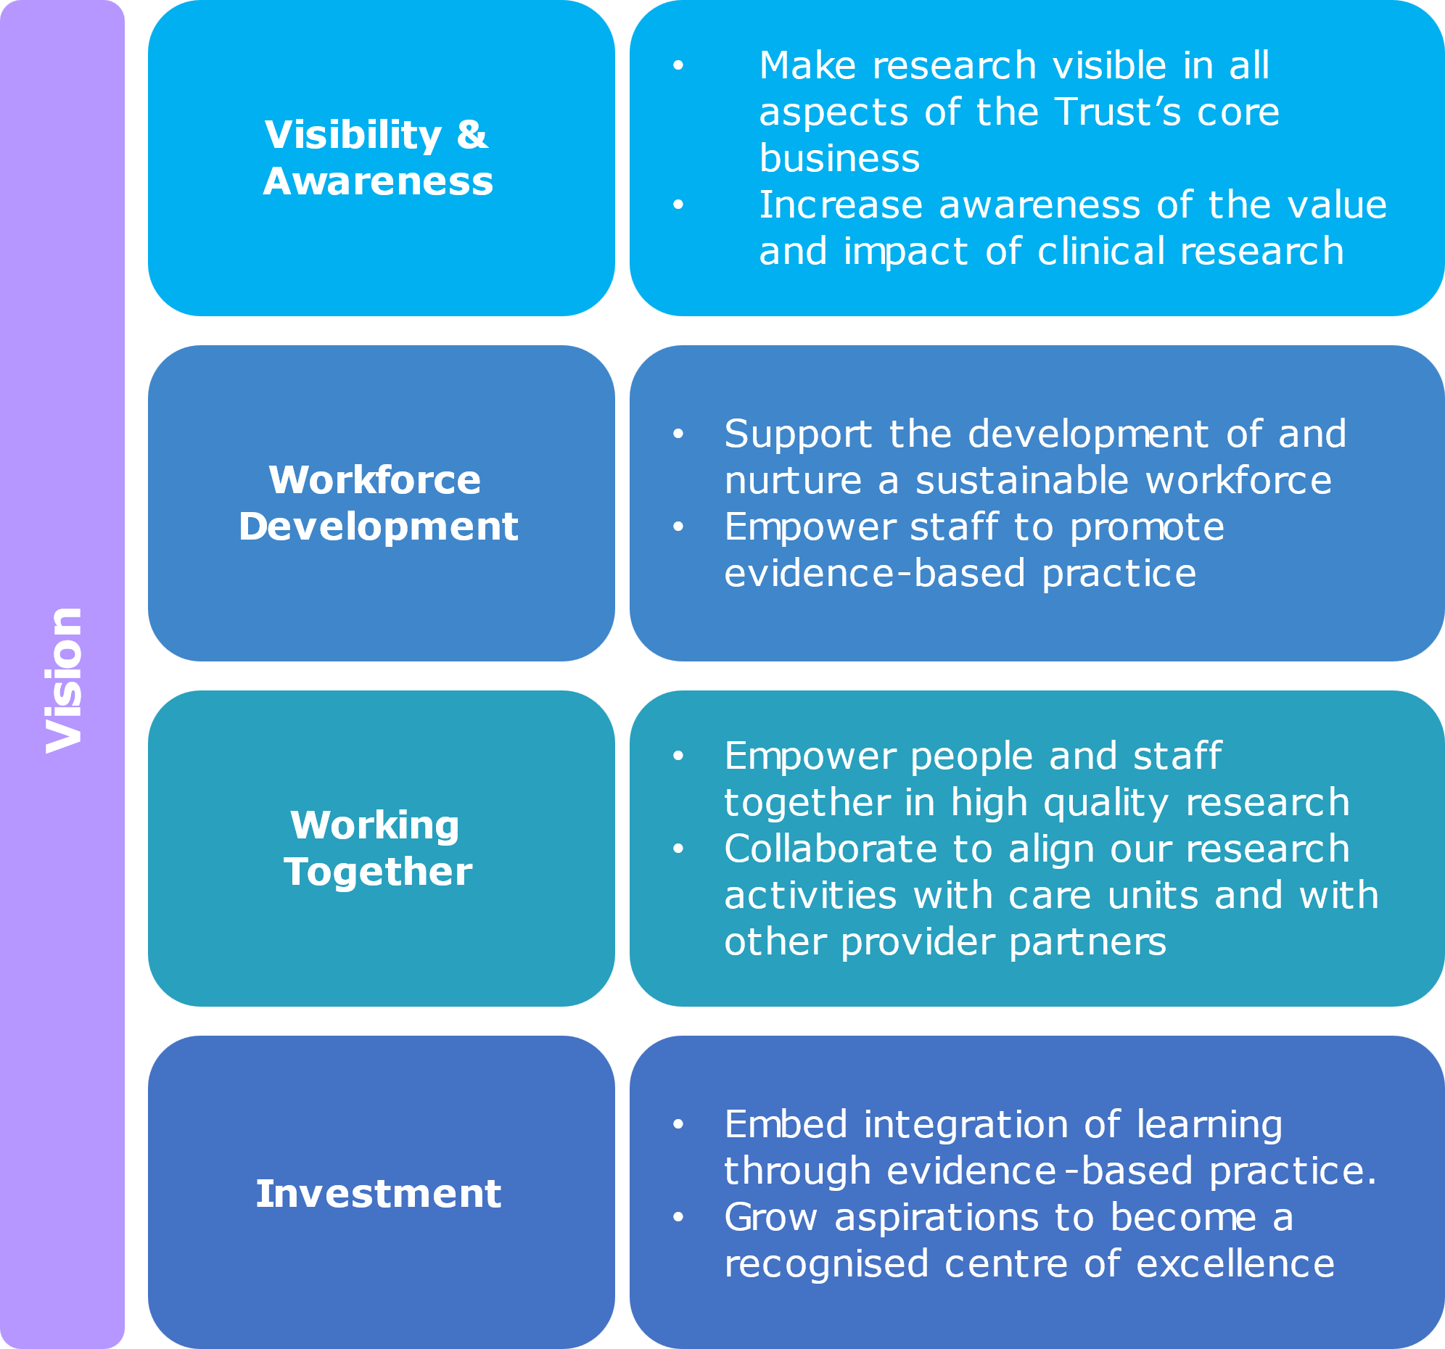
Where Do We Want To Be?
Strategic Context – Local
Our Research Strategy
The Research Strategy (2023 – 2026) was developed to highlight the importance of research, the challenges faced by the field and outlines a 3-year implementation programme to address these challenges.
Key challenges:
Workforce: the workforce is often unable to partake in research due to capacity, tools, space and access availability.
Funding sources: access to NIHR funding can be challenging
Communication: communication needs to be improved to improve research awareness and knowledge sharing
Key milestones:
Year 1: increase research awareness
Year 2: improve research activity and involvement of EPUT workforce
Year 3: increase NIHR research and grant fund portfolio, including an increase in commercial clinical trials
Key Messages – Link to Estates and Facilities
Ensuring access to sufficient and appropriate estate capacity to support the research vision
Align research activities with care units and with other provider partners
P.38

Slide 39
Where Do We Want To Be?
On-going Collaborative Working Across Our ICS
Our collaborative, partnership working between health and care providers and local government is key to promoting effective investment decision making.
We have established specific collaborative arrangements with other providers of the NHS services in:
Mid and South Essex Community Collaborative
North East Essex Community Collaborative
East of England Regional Specialist Mental Health
By continuing to build on this successful collaborative working and delivering more integrated and coordinated health and wellbeing services we will speed up care and reduce inequalities across Essex.
Mid and South Essex Community Collaborative
A partnership between three organisations: EPUT, NELFT and Provide, who’s role is to work with health and care providers to review how community services can best address the needs of the local communities. The intention of the MSE Community Collaborative is to:
Improve access and health outcomes across the population, irrespective of where the service user resides, or which organisation delivers their care
Better collaboration and partnership between the organisations to deliver best clinical practices and high-quality care
Futureproof community services by delivering services closer to the patients
Key Messages – Link to Estates
The 2024/2025 focus is to rationalise MSE community estates and deliver cost improvements related to estate utilisation
More focus should be put on partnership working to provide safe, high quality spaces and a flexible estate that responds to net zero targets
Ensure we are working with Local Authorities to keep up to date and become more involved in any discussions about new health care developments or available S106 funding.
East of England, NHS Specialist Mental Health, Learning Disability and Autism provider collaborative
The collaborative have established new ways of working together to create services and support our patients in a better way that brings together all organisation with the patient voice at the heart of all we do. The aim is to start to tackle inequalities in care and create more specialised care, closer to home by developing what we call ‘hospital at home’ type care.
Here are EPUT, we are one of the three lead providers that host the commissioning contract with NHS England for our Provider Collaborative covering adult medium and low secure services including learning disabilities and autism across the region.
P.39

Slide 40
Where Do We Want To Be?
Our Key Estate Strategy Objectives
The key objectives to inform the estate strategy (summarised below) were identified through relevant strategic policy review and targeted engagement with ICS stakeholders (listed in Appendix 2). Further detail on the principles underpinning these estate strategy objectives is provided in the pages overleaf.
P.40

Slide 41
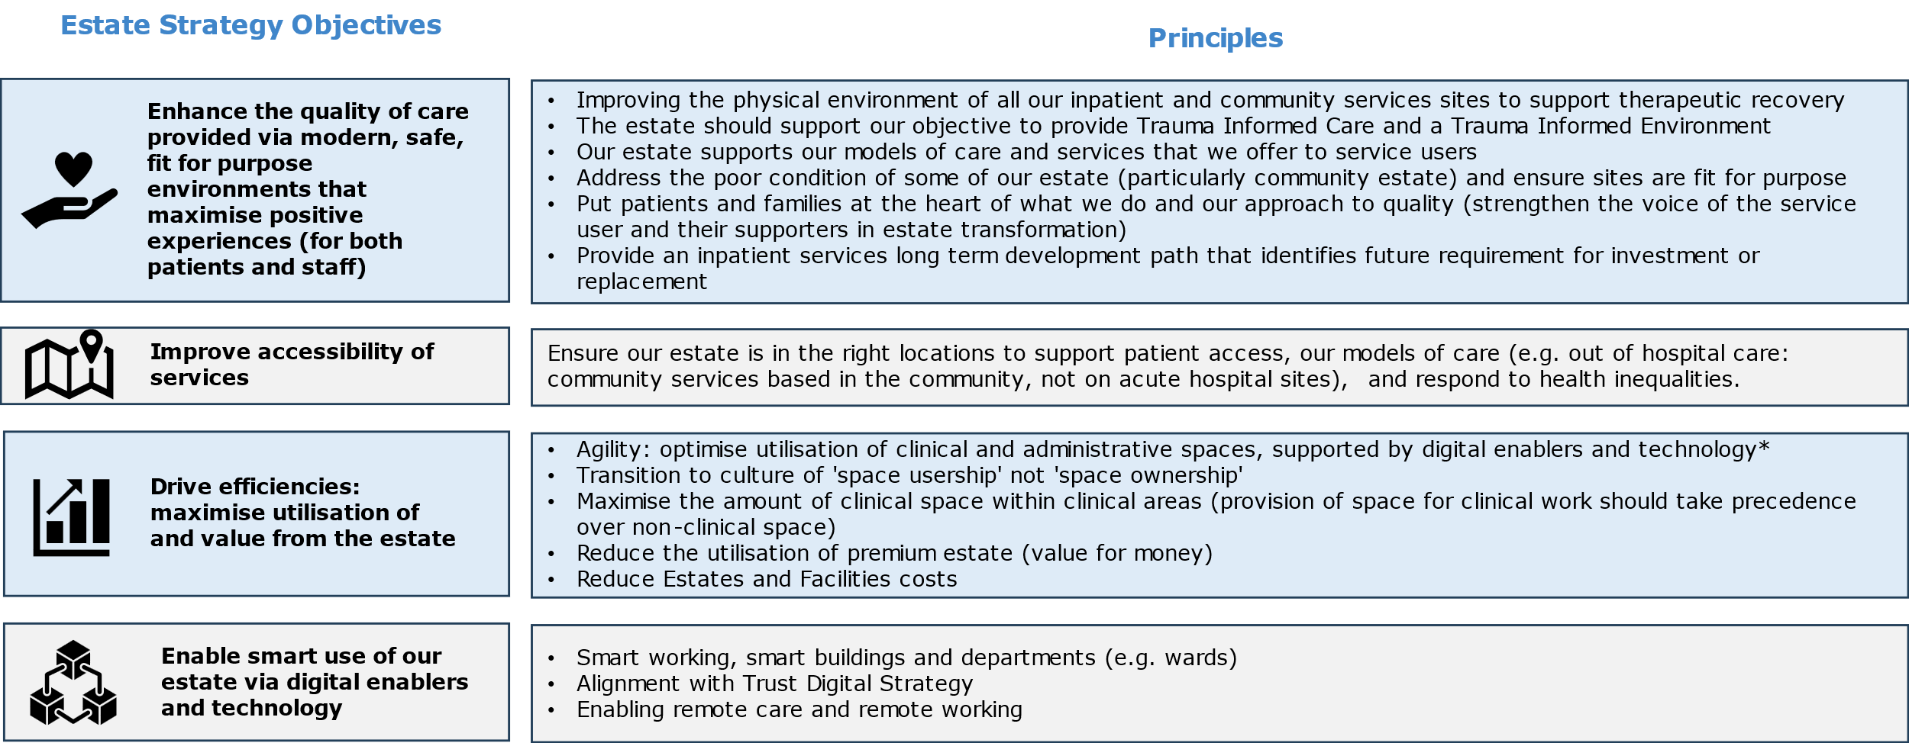
Where Do We Want To Be?
Our Key Estate Strategy Objectives and Principles
*May include use of basic technology to support agile working, such as noise cancelling headphones in agile working environments.
P.41

Slide 42
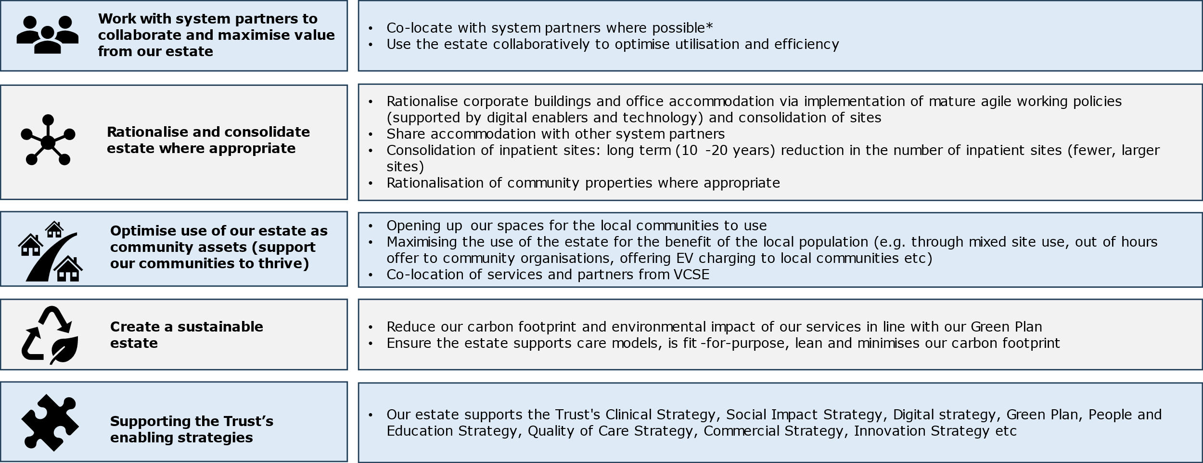
Where Do We Want To Be?
Our Key Estate Strategy Objectives and Principles cont.
Estate Strategy Objectives
Principles
*Provide some guidance on operational issues that may result from colocation of system partners e.g. contractual issues of space payment etc
P.42

Slide 43
Where Do We Want To Be?
Summary Vision: Estates Supporting Delivery of Our Strategic Plan
P.43

Slide 44
Estate Strategy 2024
4. HOW DO WE GET THERE?

Slide 45
How Do We Get There?
Introduction
To ensure we have an estate that is good quality, fit-for-purpose and aligns with our strategic vision, it is necessary evaluate the EPUT estate and identify opportunities to generate capital for future investment and relocate services to better locations. The below summarises the process of identifying the key areas of opportunity.
Long List
Key Areas and Short List
Evaluation and Preferred Options
Potential Disposals
Core, flex and tail
Stakeholder engagement workshops with key EPUT Care Unit, Operational, and Corporate stakeholders identified a long list of potential estate options to meet the key estate strategy objectives.
Further evaluation of the long list of estate options with key EPUT stakeholders identified a set of priority options/ areas.
Workshop sessions with key EPUT stakeholders identified the following criteria to evaluate clinical and non-clinical (administration space) estate options to provide an early indication of preferred options and the required direction of travel.
The Trust has identified properties for potential disposals based on those that are not fit-for-purpose or vacant.
An assessment was done on all EPUT properties (leasehold and freehold) to categorise the estate into core, flex and tail, based on 6 criteria. This exercise will inform future decisions on the estate.
P.45

Slide 46
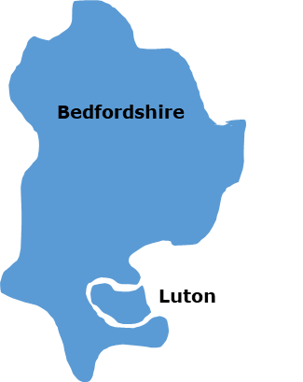
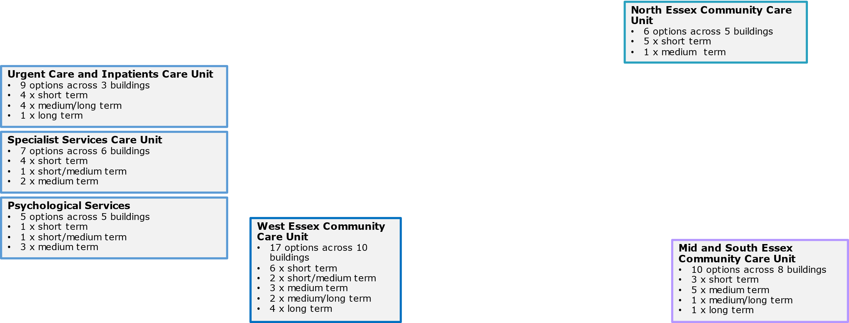
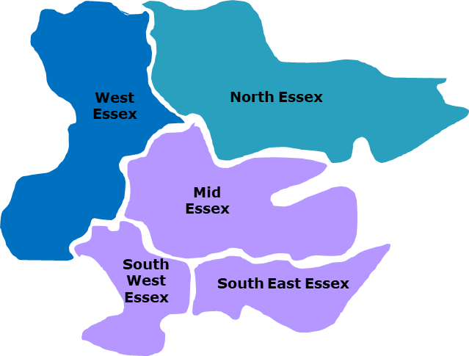
How Do We Get There?
Estate Options Development: Long List Summary
Stakeholder engagement workshops with key EPUT Care Unit, Operational, and Corporate stakeholders identified a long list of potential estate options to meet the key estate strategy objectives. A summary of the 54 options identified is provided below. Further detail on long list options is provided in Appendix 3.
Care Units Across EPUT Estate
P.46

Slide 47
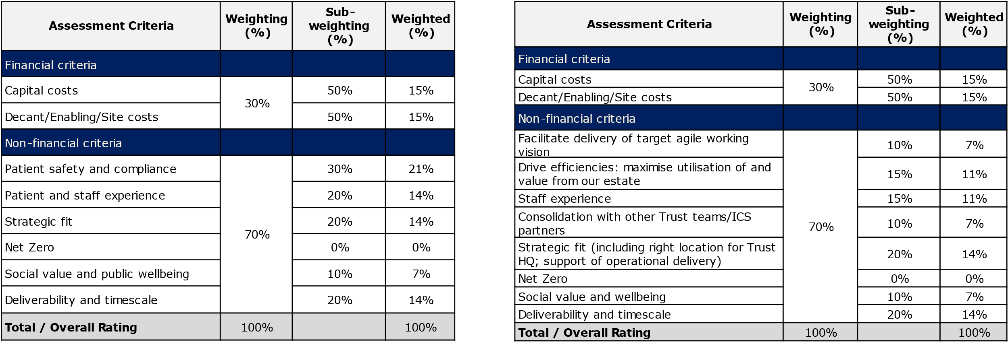
How Do We Get There?
Estate Option Evaluation Criteria and Weightings
Workshop sessions with key EPUT stakeholders identified the following criteria to evaluate clinical and non-clinical (administration space) estate options to provide an early indication of preferred options and the required direction of travel.
Clinical options - Agreed evaluation criteria and weighting
Administration options - Agreed evaluation criteria and weighting

Slide 48
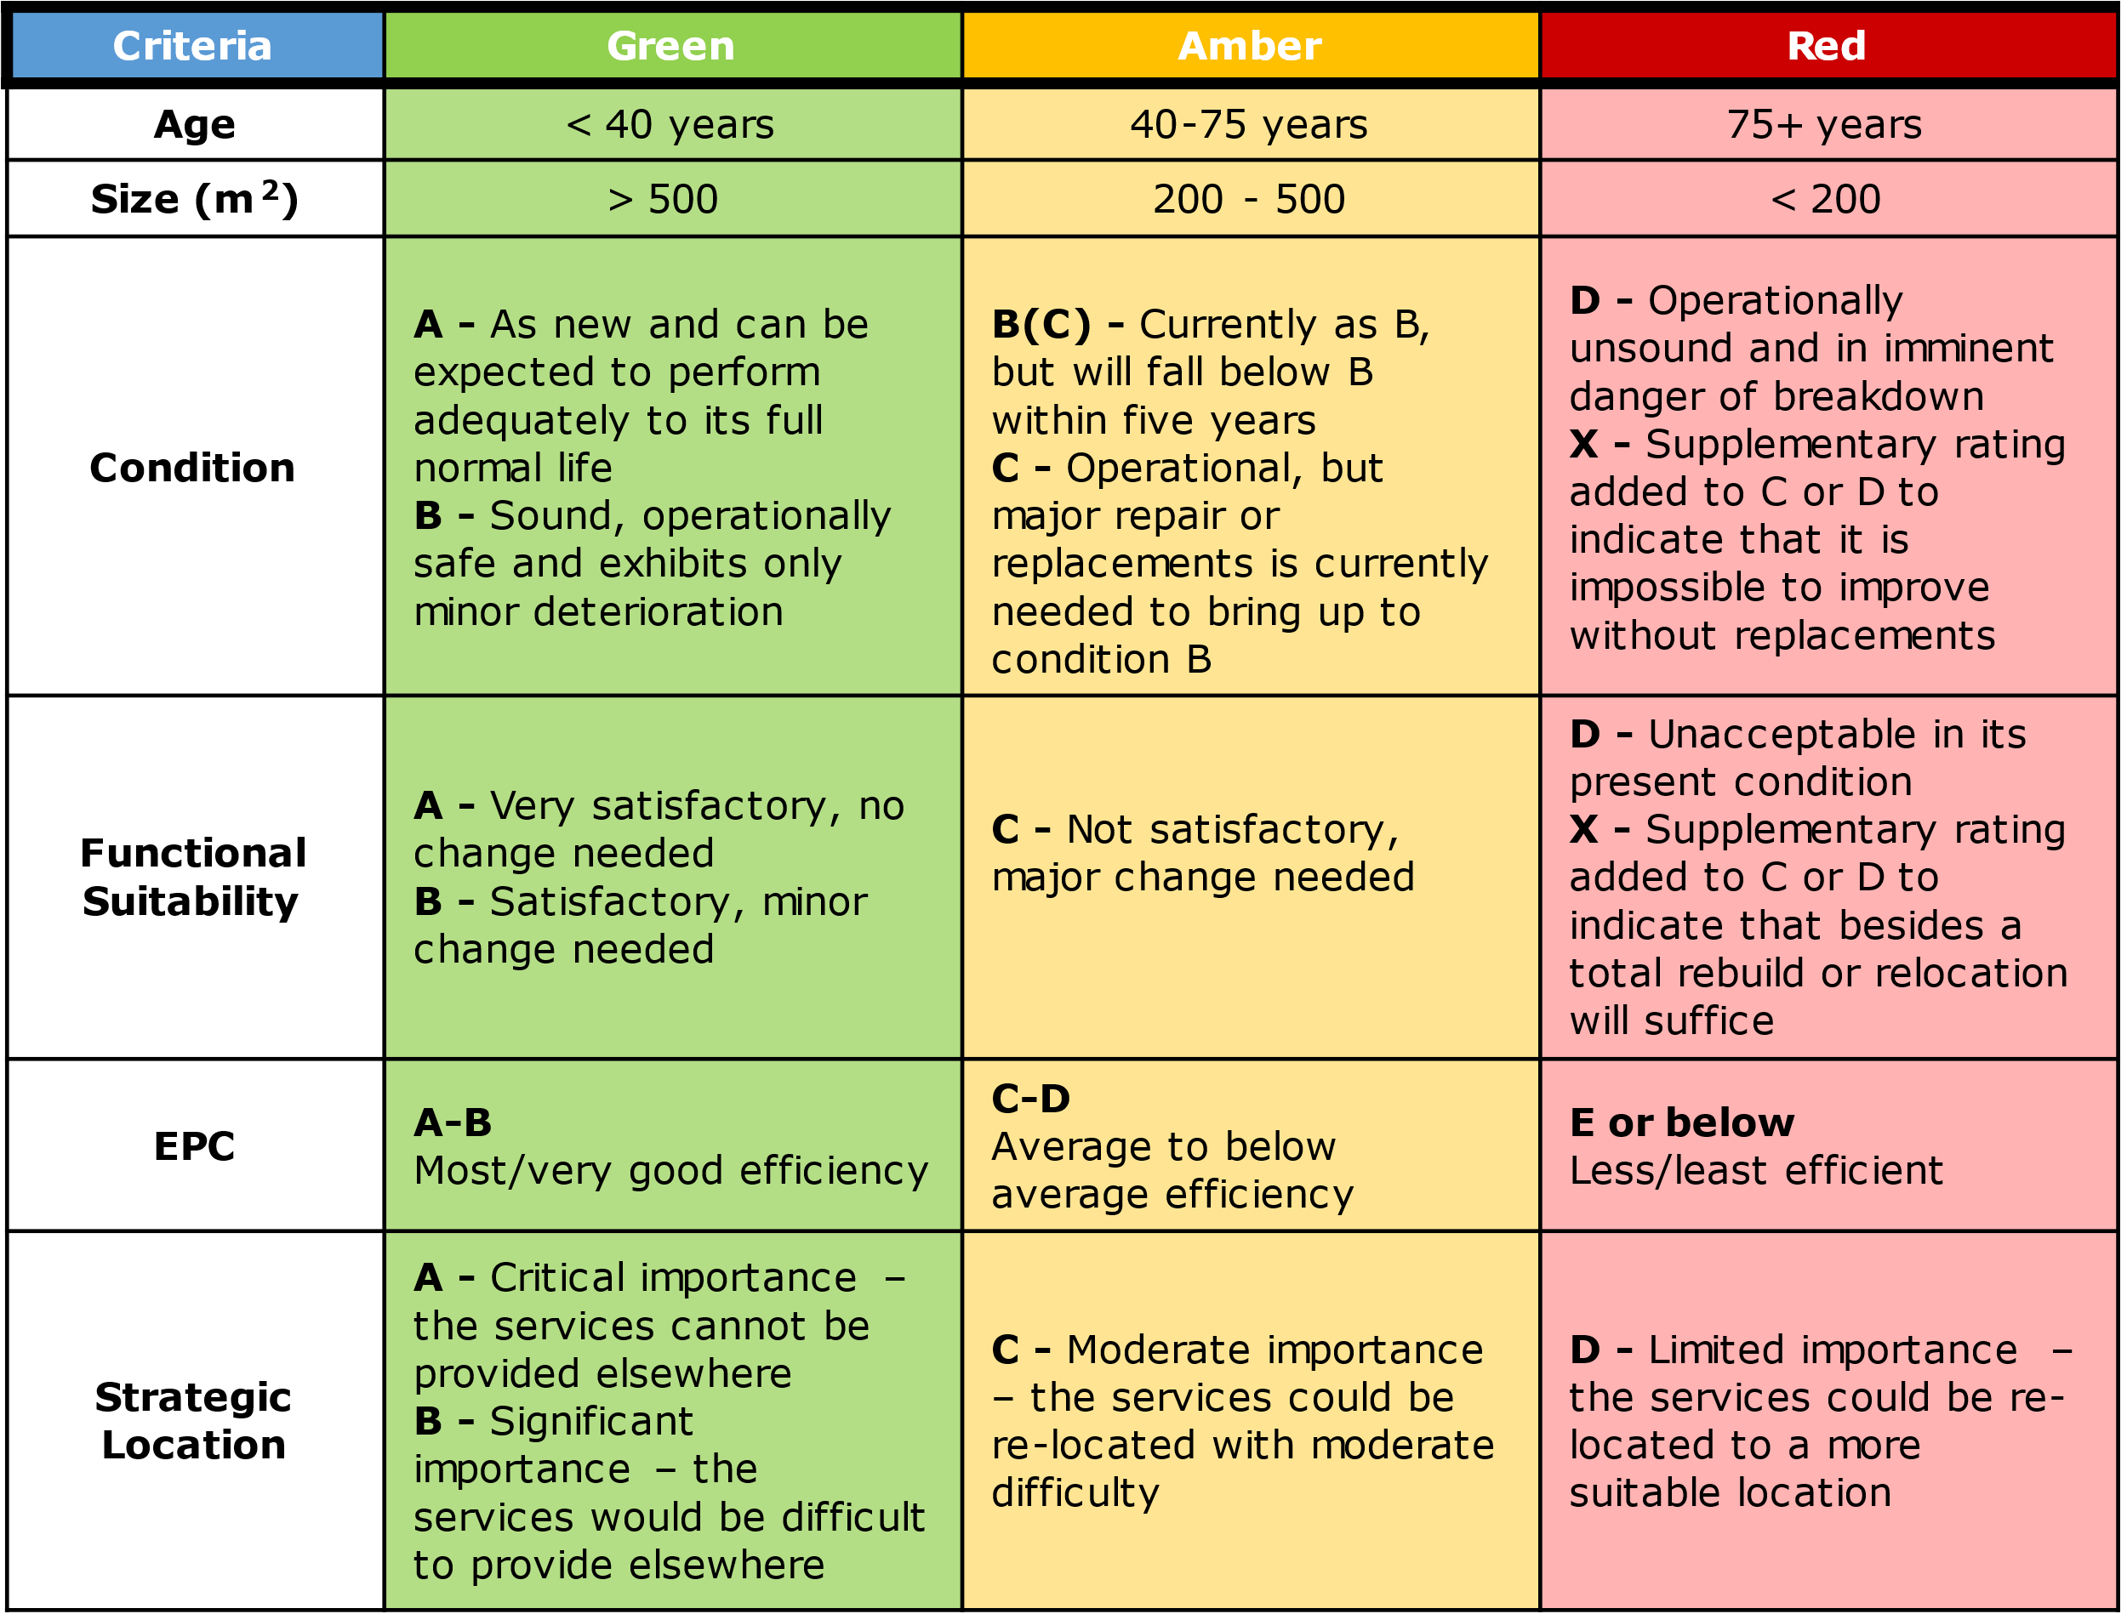
How Do We Get There?
Core, Flex and Tail
Core, Flex and Tail Evaluation Criteria
Categorisation of our estate and development requirements
A safe, modern, well-planned and patient-centred estate enables delivery of high quality services and adds value for money.
To ensure we have an estate that is good quality, fit-for-purpose and aligns with our strategic vision, it is necessary to categorise our sites into core, flex and tail.
Core – Good quality, fit-for-purpose and future-proof estate that aligns with national, regional and local strategies.
Flex – Estate that is of an acceptable quality, or provides unique access to services, but does not fully enable the strategic ambitions.
Tail – Poor quality estate that is not fit-for purpose for patient-facing services and should be phased out when alternative estate is available.
We have evaluated our estate using the following criteria:
Age
Size
Condition
Functional suitability
EPC
Strategic Location
P.48

Slide 49
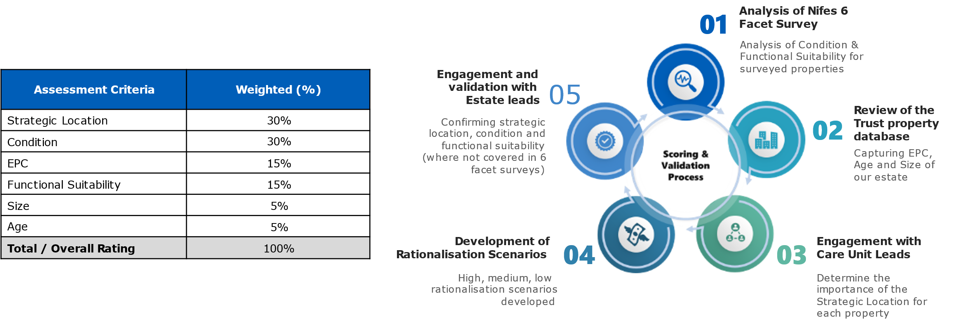
How Do We Get There?
Core, Flex and Tail
Categorisation of our estate and development requirements
Scoring and Validation Process
To categorise our estate into core, flex and tail, we have used the used the assessment criteria and weightings as per below and the scoring process as summarised opposite.
P.49

Slide 50
How Do We Get There?
Core, Flex and Tail
Development of core, flex and tail
To further analyse what our future EPUT estate could comprise, we have developed three indicative scenarios.
All three scenarios look at rationalising our estate in order of the weakest scoring assets as a result of the Rag rated property analysis.
Each scenario will generate a capital receipt which could be reinvested into upgrading our retained estate.
The next slide summarises each indicative scenario, outlining details of what the future standard estate could comprise, but also details of the potential revenue savings by exiting both non core freehold and leasehold estate, in addition to the future capital savings made by disinvestment through removal of backlog maintenance in the freehold estate.
Low
Rationalisation
Indicative
Scenarios
Moderate
Rationalisation
High
Rationalisation
P.50

Slide 51
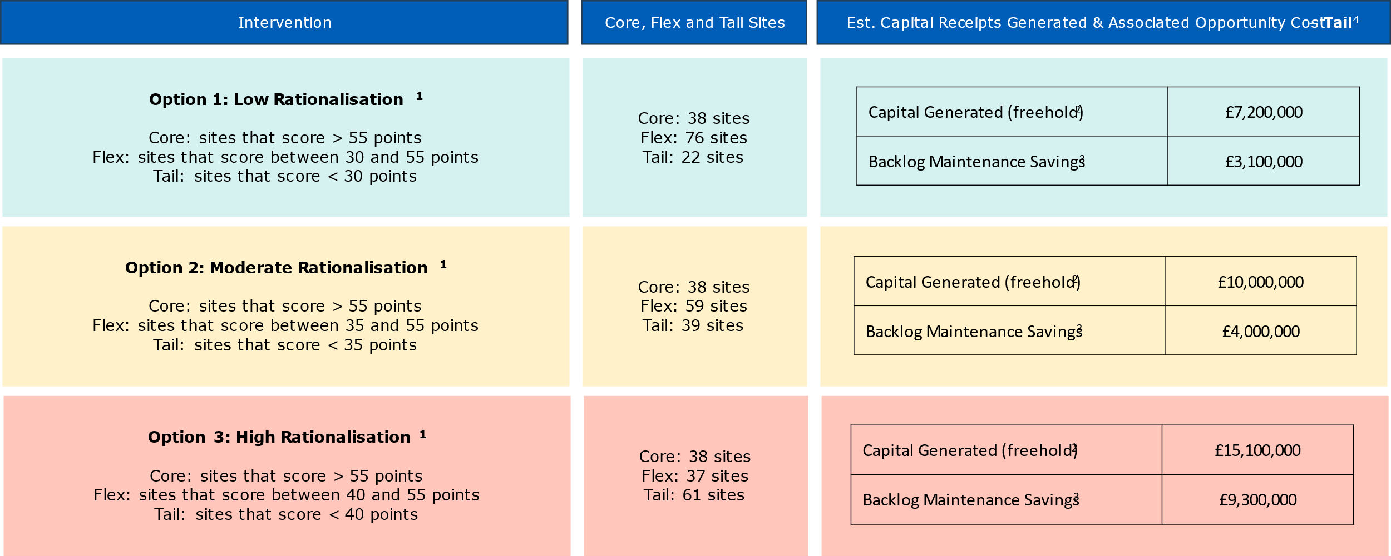
How Do We Get There?
Core, Flex and Tail – Scenario Summary
¹Based on a maximum score total of 100 points; ²Based on Net Book Values; ³Based on the information available from a Nifes 6 Facet Survey;⁴A full list of sites included can be found in the Appendix 5.
P.51

Slide 52
How Do We Get There?
Core, Flex and Tail Sites
As mentioned above, and in accordance with NHSE guidance, categorisation of our existing acute and community estate into core, flex and tail indicates that 28% of the estate is core, 44% is flex and 28% is tail¹. This categorisation enables strategic decisions to be developed, investments to be focused and rationalisation to occur. The categorisation for each Care Unit is summarised in Appendix 6. Please note that the below is based on the moderate scenario mentioned above.
¹Based on 136 properties and on the moderate scenario

Slide 53
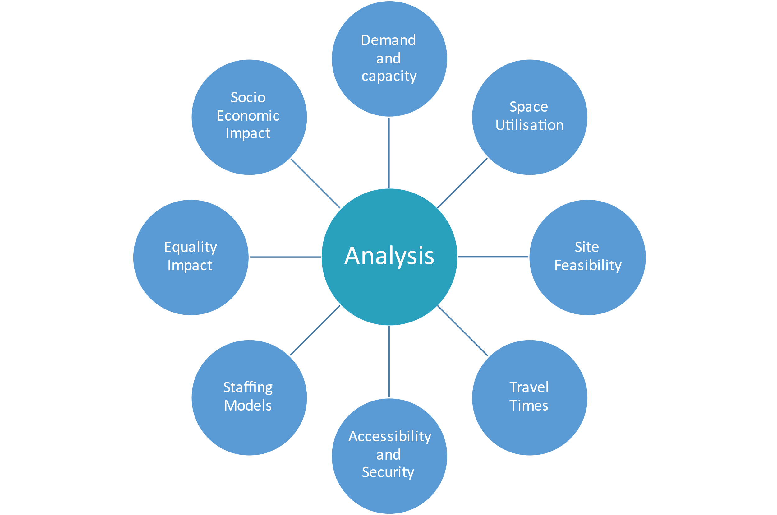
How Do We Get There?
Target Deep Dive Analysis
Our estate strategy forms a key component of a suite of EPUT enabling strategies which are interdependent and complementary to successful delivery. The EPUT enabling strategies are interdependent and must be complementary to ensure successful delivery. EPUT strategies will require regular updating.
Further detailed information and analysis may be required to inform projects and enable better evaluation and prioritisation of estate options. Further detailed information and analysis may be required to inform projects and enable better evaluation and prioritisation of estate options.
Targeted deep dive analyses will be dependent on projects but may include:
Demand and capacity modelling to determine future capacity requirements, - this analysis is particularly important for the inpatient services
Space utilisation studies to identify baseline capacity surplus/shortfall – this may be particularly relevant to the corporate estate options
Analysis to support access and travel times to specific properties and locations
Security requirements of different properties
Impact of new models of care and site locations for staffing models and requirements
Equality Impact Assessment for the estate options
Socio-Economic Impact Assessment for the estate options

Slide 54
How Do We Get There?
Working Groups Example
Following the evaluation and prioritisation of projects, an agreed prioritisation investment plan will be defined during our 10 year strategy. All projects will be subject to the development of appropriate business cases for formal approval. Business cases will establish the benefits to be realised and define the quality, costs and time parameters. Projects will be required to comply with EPUT’s policy and procedures for managing capital projects. Discrete project boards should be established to deliver the agreed projects. Each project board will be led by a Project Director, under the overall leadership of a Senior Responsible Owner, with a clear responsibility to ensure that the project is delivered within the agreed parameters and realises the expected benefits.
The Trust is proposing to establish a series of working groups to drive projects forward and align project objectives with core Trust objectives. One such working group would explore opportunities around vacating tail estate to optimise service delivery, generate capital receipts and annual revenue savings, and reduce backlog maintenance costs. This will develop on from the work undertaken within the strategy to identify the core flex and tail estate.
The initial priority is to dispose/sell the 5 identified properties, as seen on page 54, followed by an evaluation of currently empty properties owned by the Trust. The disposal of our estate is subject to our internal approval process, requires careful consideration and consultation with staff, patients, and the public, where necessary, prior to making any final decisions. We will also actively collaborate with our system partners to ensure we deliver the best health outcomes to our local population through estate reconfiguration and rationalisation. This process will be supported by robust business cases on a property-by-property basis.
An assessment needs to be done on the properties that are currently leased out to determine the benefits of selling that estate. Following the evaluation and prioritisation of projects, an agreed investment plan will be defined. Projects will be required to comply with EPUT’s policy and procedures for managing capital projects. Discrete project boards should be established to deliver the agreed projects. Please refer to Appendix 7 for further details on the proposed working group objectives and governance structure.

Slide 55
5. FUNDING, DELIVERY AND MEASURING SUCCESS

Slide 56
How Do We Get There?
Funding Options
The decision tree below sets out a shortlist of potential funding options and relevant structures, focusing on new developments. The development and viability will need to be worked through collaboratively with EPUT and the chosen route will be dependent on the ability to obtain appropriate CDEL cover. This doesn’t account for the revenue savings of colocation and exiting buildings. Additional sources of capital would include Section 106, CIL and OPE funding.
P.56

Slide 57
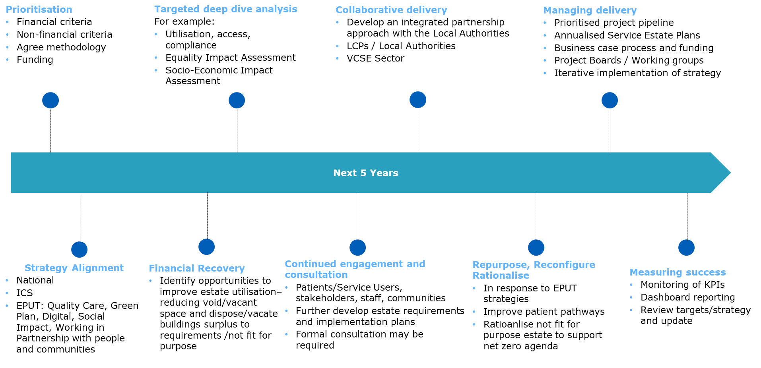
How Do We Get There?
Delivering the Vision – Key Steps
We are developing a clear prioritised plan to deliver the estate strategy vision. Next steps will involve the development of implementation plans that further establish key actions and additional new working groups to be undertaken to deliver the estate strategy. A high level timeline for implementation and delivery of key projects within the strategy is included within Appendix 8.
P.57

Slide 58
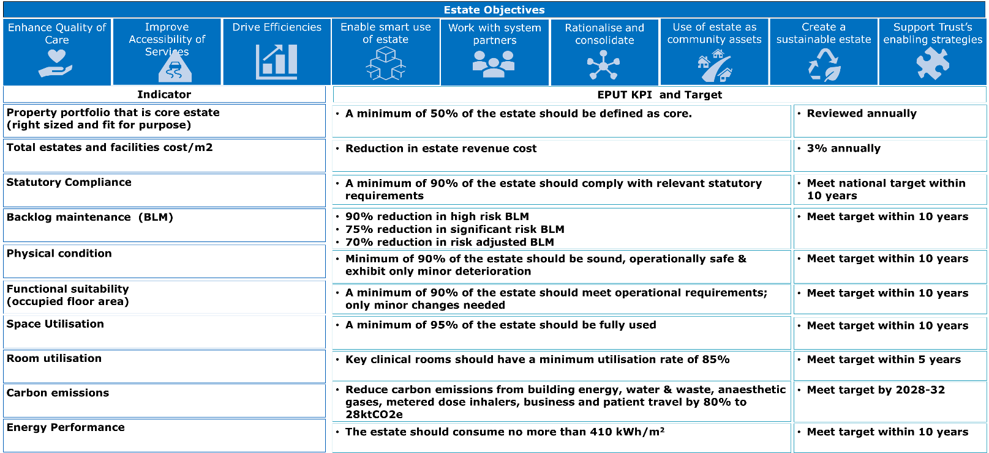
How Do We Get There?
Measuring Success
Through individual stakeholder meetings and workshops, we have identified several key estate objectives and associated KPI’s to measure success and performance against. The key estate objectives and associated KPI’s can be found below. Implementation of the estate strategy will be an iterative process that must be flexible and able to respond to changing needs, priorities and financial challenges of EPUT.
Delivery Assurance:
Twice yearly delivery reviews with finance and planning committee

